Slide 1
Big Data Ingestion
Introduction to Big Data Ingestion
Notes:
The module name "Introduction to Big Data Ingestion" suggests that it covers the fundamental concepts and techniques related to the process of ingesting large volumes of data for big data analytics. It indicates a focus on understanding the methods and tools used to collect, process, and store massive datasets for analysis and decision-making purposes.

Slide 2

Case Study: Data Corp
John Anderson
(CDE at Data Corp )
Company Background:
Data Corp has been a leading player in the financial sector for over a decade.
Serving millions of customers worldwide, they offer a range of products from savings accounts to complex financial instruments.
With the rise of digital transactions, Data Corp has seen an exponential increase in the volume of data they handle daily.
Notes:
**Detailed Notes:**
- Data Corp is a prominent player in the financial sector, providing a variety of financial products to millions of customers globally.
- The company has witnessed a significant surge in the volume of data they manage on a daily basis due to the growing prevalence of digital transactions.
**Key Points:**
- Data Corp is a well-established financial firm catering to a large customer base.
- The company's services range from traditional savings accounts to intricate financial tools.
- The advent of digital transactions has led to a substantial upsurge in the amount of data processed by Data Corp on a daily basis.
**For Students:**
Data Corp is a big financial company that serves many customers worldwide. With more people using digital ways to do transactions, the company now has a lot more data to handle every day.

Slide 3

Case Study: Data Corp
John Anderson
(CDE at Data Corp )
Current Situation & Challenges:
As Data Corp ventured into the new age of digital finance, they faced a sudden surge in data, much of which was unstructured and spread across multiple sources like web logs, customer feedback, transaction data, and mobile app analytics.
The sheer volume of this data made it challenging to process, analyze, and extract meaningful insights in real-time.
Mr. John Anderson, the Chief Data Officer at Data Corp, voiced the problem succinctly, "We are drowning in information, but starving for insights.
The traditional data handling tools are no longer sufficient for the new age challenges."
Notes:
Notes:
- Data Corp is a prominent player in the financial sector for over a decade, offering a wide range of products globally.
- The company has experienced a significant surge in data volume due to the rise of digital transactions.
- Unstructured data from various sources like web logs, customer feedback, transaction data, and mobile app analytics has become challenging to process and analyze in real-time.
- John Anderson, the Chief Data Officer at Data Corp, highlighted the issue of being overwhelmed with data while lacking actionable insights.
- Traditional data handling tools are no longer adequate for the current data challenges.
For Students:
Data Corp, a major player in finance, is struggling with a large amount of unorganized data from different sources like customer feedback and transaction data. This has made it difficult for them to process and find useful insights quickly. Their current tools are not able to handle these new data challenges.

Slide 4

Case Study: Data Corp
John Anderson
(CDE at Data Corp )
The Solution – Big-data Ingestion :
To address the challenges, Mr. Anderson initiated the integration of a Big Data Ingestion tool. This tool, equipped with modern data processing capabilities, was able to collect, integrate, and preprocess vast amounts of unstructured and structured data in real-time. Not only did it consolidate data from various sources, but it also standardized it, making it ready for analytics.
The team, under John's leadership, also invested in training sessions for their analysts to familiarize them with the new system and maximize its potential.
Notes:
Summary:
Data Corp, a leading player in the financial sector, faced challenges in handling the exponential increase in unstructured data resulting from the rise of digital transactions. Mr. John Anderson, the Chief Data Officer, recognized the need for modern data processing capabilities to effectively handle and analyze this data.
Key Points:
- Data Corp faced a surge in unstructured data from various sources including web logs, customer feedback, transaction data, and mobile app analytics.
- The traditional data handling tools were no longer sufficient for the new age challenges.
- Mr. Anderson initiated the integration of a Big Data Ingestion tool to address the challenges.
- The Big Data Ingestion tool collected, integrated, and preprocessed vast amounts of unstructured and structured data in real-time. It also standardized the data for analytics purposes.
- Training sessions were conducted for the analysts to familiarize them with the new system and maximize its potential.
For Students:
Data Corp, a financial company, had a problem dealing with a huge amount of messy data from different sources like customer feedback and web logs. To solve this, Mr. Anderson introduced a new tool that could organize and make sense of all this data in real-time. He also trained the team to use this tool effectively.

Slide 5

Case Study: Data Corp
John Anderson
(CDE at Data Corp )
The Result:
Data Corp saw a 70% reduction in data processing times.
Real-time insights allowed managers and decision-makers to make data-backed choices, resulting in a 30% increase in customer satisfaction and a 20% rise in sales.
With all data centralized and streamlined, the company could now predict market trends and customer behaviors with 90% accuracy.
Data analysts and scientists, now freed from mundane data processing tasks, focused on strategic projects, leading to the launch of three new financial products in just six months.
Mr. Anderson remarked, "Big Data Ingestion didn't just solve our data problem; it transformed the way we do business. Today, we're not just reacting to market changes; we're predicting and shaping them."
Notes:
Summary:
Data Corp, a leading player in the financial sector, faced challenges with a surge in unstructured data from various sources due to the rise of digital transactions. Mr. John Anderson, the Chief Data Officer, recognized the need for a modern data processing solution to address these challenges. As a solution, the company integrated a Big Data Ingestion tool, resulting in significant improvements and transformative changes in their operations.
Key Points:
- Data Corp encountered a sudden surge in unstructured data from web logs, customer feedback, transaction data, and mobile app analytics, making it challenging to process and analyze the data in real-time.
- Mr. John Anderson initiated the integration of a Big Data Ingestion tool, which could collect, integrate, and preprocess vast amounts of unstructured and structured data in real-time, consolidating data from various sources and standardizing it for analytics.
- The implementation of the Big Data Ingestion tool resulted in a 70% reduction in data processing times, a 30% increase in customer satisfaction, a 20% rise in sales, and the ability to predict market trends and customer behaviors with 90% accuracy.
- Data analysts and scientists were able to focus on strategic projects, leading to the launch of three new financial products in just six months.
For Students:
Data Corp, a financial company, faced a problem with the overwhelming amount of data they were dealing with due to the increase in digital transactions. To solve this, they introduced a new tool that helped them manage and understand this data better. This tool made a big difference, helping the company work faster, make better decisions, and even predict future trends.

Slide 6
This underscores the significance of Big Data Injection for organizations across segments.
Let's study more about Big-Data Injection in this Module
Notes:
Summary:
This quote emphasizes the importance of studying Big Data Injection and its significance for organizations across various industries. It highlights the crucial role of Big Data Injection in addressing data challenges and transforming the way businesses operate.
Key Points:
- Big Data Injection is a critical topic for organizations.
- It plays a significant role in addressing data challenges.
- Big Data Injection has a transformative impact on business operations.
- Understanding Big Data Injection is essential for organizations across different sectors.
- It signifies the growing importance of data management and processing techniques.
- Organizations need to recognize the value of Big Data Injection for their data strategies.
- Big Data Injection is relevant for improving data processing and analysis.
- It underlines the need for organizations to leverage Big Data Injection effectively.
- The quote stresses the relevance of studying Big Data Injection for businesses to thrive in the data-driven era.
- Organizations should prioritize learning and implementing Big Data Injection for sustainable growth and success.

Slide 7
Module Coverage
Big Data Architecture
• Big Data Architecture Overview
• Sources of Big Data
Introduction to Data Ingestion
• Introduction to Data Ingestion
• Batch vs Stream Data Ingestion
Data Ingestion Pipeline
• ETL vs ELT
• Key Factors for Data Ingestion Pipeline
Applications of Data Ingestion
• Case 1: E-commerce company
• Case 2: Bank
Challenges in Data Ingestion
Selecting Data Ingestion Tools
Commonly Used Data Ingestion Tools
Summary
Key Points to remember
References
Notes:
1. Big Data Architecture Overview: Understanding the overall structure and components of big data systems.
2. Sources of Big Data: Identifying the various origins and types of big data.
3. Introduction to Data Ingestion: Exploring the process of collecting and importing large volumes of data.
4. Batch vs Stream Data Ingestion: Comparing the methods of processing and transferring data in bulk or in real-time.
5. ETL vs ELT: Differentiating between Extract, Transform, Load and Extract, Load, Transform methods for data integration.
6. Key Factors for Data Ingestion Pipeline: Understanding the essential elements for an efficient data ingestion process.
7. Data Ingestion Pipeline Cases: Analyzing data ingestion scenarios in an e-commerce company and a bank.
8. Applications of Data Ingestion: Exploring practical uses of data ingestion in various industries.
9. Challenges in Data Ingestion: Identifying the obstacles and issues encountered during the data ingestion process.
10. Selecting Data Ingestion Tools: Evaluating the criteria for choosing suitable tools for data ingestion.
11. Commonly Used Data Ingestion Tools: Exploring the popular tools employed for data ingestion.
12. Key Points to Remember: Summarizing the crucial takeaways from the module.
13. References: Listing the sources for further exploration.
14. Summary: Recapping the main concepts covered in the module.

Slide 8
Big Data Architecture
• Big Data Architecture Overview
• Sources of Big Data
Notes:
The section provides an overview of big data architecture, including an exploration of the sources of big data and a more detailed examination of the overall architecture. Key points include understanding the structure of big data systems and the various sources from which big data is derived.

Slide 9
Big Data Architecture involves organizing and integrating components, technologies, and processes for efficient collection, storage, processing, and analysis of large datasets. It ensures smooth data flow, scalability, and optimal performance, enabling organizations to leverage their data effectively.
What is Big-Data Architecture?
Notes:
Notes:
- Big Data Architecture involves organizing and integrating components, technologies, and processes for efficient collection, storage, processing, and analysis of large datasets.
- It enables smooth data flow, scalability, and optimal performance, allowing organizations to leverage their data effectively.
Key Points:
- Organizing and integrating components, technologies, and processes for efficient collection, storage, processing, and analysis of large datasets.
- Ensuring smooth data flow, scalability, and optimal performance.
For Students:
Big Data Architecture is like designing a highway system for data. It's about creating a structure that allows large amounts of data to move, be stored, and processed efficiently, helping organizations make the most of their data resources.

Slide 10


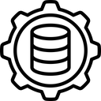
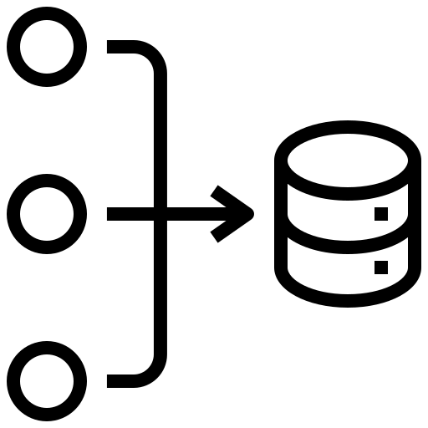
Big Data Architecture
Big data architecture forms the basis for big data analytics, serving as the comprehensive system to handle substantial data volumes for analysis, guiding data analytics efforts. It offers an environment where tools extract crucial business insights from initially intricate data. This architecture blueprint defines the structure of big data infrastructures, outlining components, data flow, and security aspects, thus acting as a reference framework for designing effective big data solutions.
Management & Storage
Big Data Sources
Analysis
Consumption
The architecture components of big data analytics typically consists of four logical layers and performs four major processes:
Notes:
Big Data Architecture:
- Big data architecture serves as a comprehensive system for handling substantial data volumes for analysis, guiding data analytics efforts.
- It forms the basis for big data analytics, providing an environment for tools to extract crucial business insights from complex data.
- The architecture blueprint defines the structure of big data infrastructures, outlining components, data flow, and security aspects, serving as a reference framework for designing effective big data solutions.
- The architecture components of big data analytics typically consist of four logical layers and perform four major processes: data sources, data storage, data processing, and data presentation.
For Students:
Big data architecture is like the blueprint of a house. It provides a structured plan for handling large amounts of data, making it easier to analyze and use for making decisions. It's like a map that guides how data is collected, stored, processed, and presented, helping organizations make sense of their big data.

Slide 11
Big Data Architecture
Sources Layer
In a big data environment, the capability exists to efficiently handle both batch processing and real-time processing of extensive data sources. These sources encompass a variety of origins, including data warehouses, relational database management systems, SaaS, and IoT devices.
Management & Storage Layer
This segment receives data from various sources, translates it into a format compatible with data analytics tools, and stores the processed data in the transformed format, facilitating effective analysis.
Analysis Layer
this layer is where various analytics tools come into play. These tools play a pivotal role in extracting pertinent business intelligence from the reservoir of data stored in the big data storage layer.
Consumption Layer
the consumption layer is the interface through which results obtained from the big data analysis layer are received. These results are then channeled and presented to the appropriate output layer, which is also referred to as the business intelligence layer.
Notes:
Big Data Architecture Overview:
- Big Data Architecture involves organizing and integrating components, technologies, and processes for efficient collection, storage, processing, and analysis of large datasets.
- It ensures smooth data flow, scalability, and optimal performance, enabling organizations to leverage their data effectively.
For Students:
Big Data Architecture is like the blueprint of a system that helps handle and analyze a huge amount of data. It helps to make sense of complex data and is important for businesses to make smart decisions.
Big Data Architecture Components:
- Sources Layer: Efficiently handles batch and real-time processing of extensive data from various origins including data warehouses, relational database management systems, SaaS, and IoT devices.
- Management & Storage Layer: Receives and stores processed data in a format compatible with data analytics tools, enabling effective analysis.
- Analysis Layer: Utilizes analytics tools to extract pertinent business intelligence from the data stored in the big data storage layer.
- Consumption Layer: Receives and presents the results obtained from the big data analysis layer to the business intelligence layer.
For Students:
Big Data Architecture has different layers that work together to handle and analyze data from different sources, making it easier for businesses to use this information to make important decisions.

Slide 12


Components of Big Data Architecture
Storage: This is where the data is stored and managed.
HDFS
This is the primary storage system of Hadoop. It is a distributed file system that allows you to store large files across multiple machines.
Hbase
This is a distributed, scalable, big data store, modelled after Google's BigTable. It is built on top of HDFS and provides random real-time read/write access to big data.
Notes:
Notes:
- Storage is a crucial component of big data architecture, responsible for storing and managing vast volumes of data.
- It involves the use of distributed file systems, databases, and data lakes to accommodate and organize diverse types of data.
- The storage layer ensures scalability, fault tolerance, and efficient data retrieval for processing and analysis.
For Students:
Think of storage in big data architecture like a massive warehouse where all the data is kept. It's like having a huge library to store and organize different types of information, making it easy to find and use when needed.

Slide 13


Components of Big Data Architecture
Processing: For transforming and analyzing the data.
MapReduce
This is a programming model and processing engine for parallel computation. It divides the task into small parts and assigns them to many computers, and then collects the results to form the output.
Spark
This is an open-source distributed computing system that is designed for fast computation. It provides APIs for data analysis, machine learning, graph analysis, and streaming live data. Spark is generally faster than MapReduce.
Notes:
Summary:
- Storage and Processing are two essential components of Big Data Architecture.
- Storage involves the management and storage of data.
- Processing is responsible for transforming and analyzing the data.
Key Points:
- Big Data Architecture consists of various components for efficient handling and analysis of large datasets.
- Storage is where data is stored and managed, while Processing involves transforming and analyzing the data.
For Students:
Big Data Architecture has two important components. Storage is like a data warehouse where information is stored, and Processing is like a factory where the data is transformed and analyzed to extract useful insights.

Slide 14


Components of Big Data Architecture
Analysis: This involves querying the data to extract meaningful insights.
Hive
This is a data warehousing and SQL-like query language that presents data in the form of tables. It is used for data summarization, query, and analysis.
Impala
This is a massively parallel processing SQL query engine that runs on Apache Hadoop. It is used for querying large amounts of data in real-time.
Notes:
Notes:
- Big data architecture forms the foundation for big data analytics, providing a comprehensive framework for managing and analyzing large datasets efficiently.
- It encompasses various components and processes to guide data analytics efforts and extract crucial business insights from complex data.
- The architecture typically consists of four logical layers: sources, management & storage, analysis, and consumption.
- Each layer serves a specific function in the data processing and analysis workflow, contributing to the overall big data architecture.
For Students:
Big data architecture is like a structure that helps organize and understand large amounts of data. It includes different parts that work together to store, process, and analyze the data so that we can learn important things from it, like predicting trends or making business decisions.

Slide 15
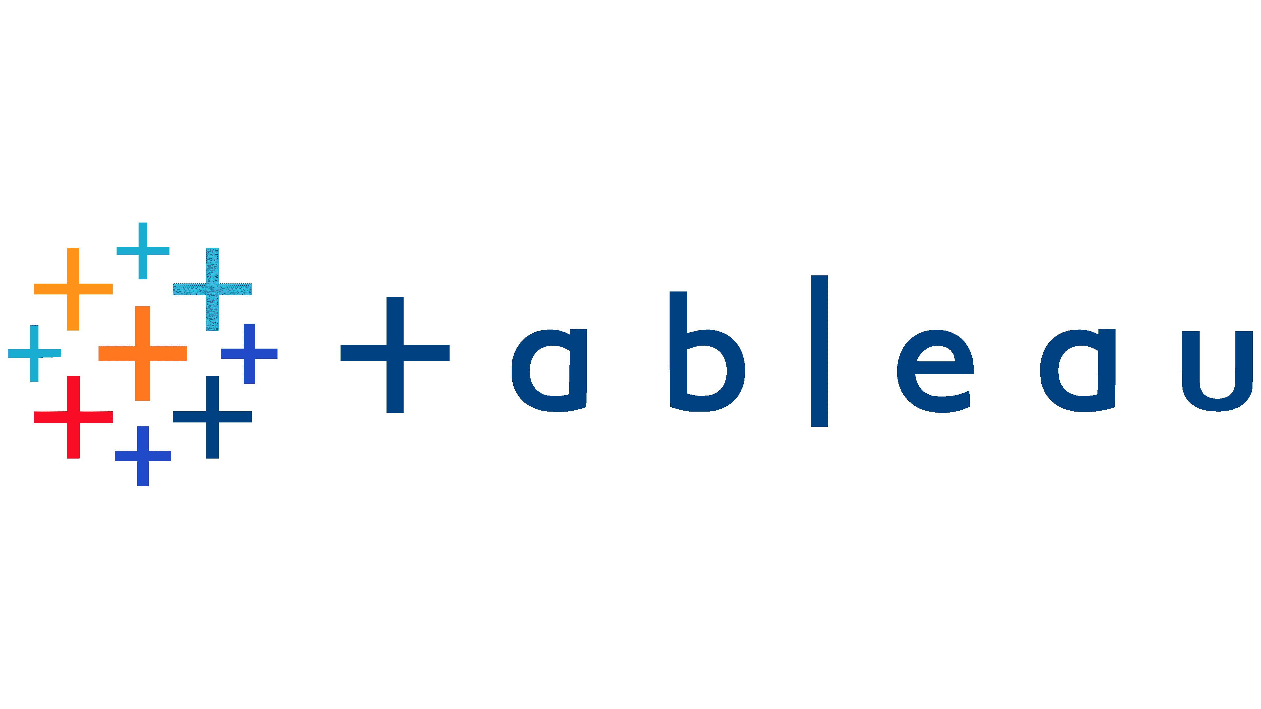

Components of Big Data Architecture
Visualization: Presenting the data in a visual format like charts, graphs, reports, etc.
Tableau
This is a data visualization tool that is used for converting raw data into an understandable format; graphs and visuals.
PowerBI
This is a business analytics tool that is used to create reports and dashboards using data from a wide range of sources.
Notes:
Components of Big Data Architecture:
- Storage: Where the data is stored and managed.
- Processing: Involves transforming and analyzing the data.
- Analysis: Querying the data to extract meaningful insights.
- Visualization: Presenting the data in visual formats like charts, graphs, and reports.
For Students:
Imagine the big data architecture as a big library where books represent data. The storage is like the shelves where books are kept, processing is like reading and understanding the books, analysis is like finding important information in the books, and visualization is like presenting the interesting parts of the books with pictures and graphs.

Slide 16


Big Data Architecture
Data Sources
Data Storage
Batch
Processing
Analytics and Reporting
Analytical Data Store
Real Time Ingestion
Stream Processing
Orchestration
Notes:
Big Data Architecture
- Data Sources:
- Refers to the various origins from which data is gathered, including data warehouses, relational database management systems, SaaS, and IoT devices.
- Real-Time Ingestion:
- Involves processing data as it is generated, allowing for immediate analysis and decision-making.
- Batch Processing:
- Involves processing large volumes of data in a scheduled or periodic manner, which is efficient for handling significant data loads.
- Orchestration:
- The process of coordinating and managing the various components and processes within the big data architecture to ensure seamless functioning.
- Data Storage:
- Involves the management and storage of the collected data, ensuring it is easily accessible for analysis.
- Analytical Data Store:
- A specialized database designed for data analysis and reporting, enabling efficient querying and retrieval of data for analytical purposes.
- Stream Processing:
- Involves real-time processing of data streams, allowing for immediate analysis and actions based on the incoming data.
- Analytics and Reporting:
- Refers to the tools and processes used to extract insights and present data in a meaningful format for decision-making.
For Students:
Big Data Architecture includes gathering data from various sources, processing it in real-time or in batches, storing it, and then analyzing and presenting it for making important business decisions.

Slide 17




Sources of Big Data Generation
Web & social media
The largest sources of Big Data. It includes clicks, logs, posts, tweets, etc. Every interaction of users with the internet, be it clicking on a link, liking a post, sharing a tweet, etc. generates data. Social media platforms like Facebook, Twitter, Instagram, etc., generate a huge amount of data daily.
Clicks
Log
Posts
tweets
Notes:
For Students:
Big Data Architecture refers to how companies handle and use large amounts of data. It's like a system that helps companies manage and understand all the information they collect.
- Big Data Architecture involves organizing and integrating components, technologies, and processes for efficient collection, storage, processing, and analysis of large datasets.
- Big data architecture forms the basis for big data analytics, serving as the comprehensive system to handle substantial data volumes for analysis, guiding data analytics efforts.
- The architecture components of big data analytics typically consist of four logical layers: Sources, Management & Storage, Analysis, and Consumption.
Sources Layer:
- Efficiently handles both batch processing and real-time processing of extensive data sources.
- Includes data from sources like data warehouses, relational database management systems, SaaS, and IoT devices.
Management & Storage Layer:
- Receives data from various sources, translates it into a format compatible with data analytics tools, and stores the processed data in the transformed format.
Analysis Layer:
- Utilizes various analytics tools to extract pertinent business intelligence from the reservoir of data stored in the big data storage layer.
Consumption Layer:
- Acts as the interface for receiving results obtained from the big data analysis layer and presents them to the appropriate output layer, also known as the business intelligence layer.

Slide 18



Sources of Big Data Generation
Mobile devices
Mobile devices generate data from apps, GPS, sensors, etc. Every app that is used, every location that is accessed via GPS, every activity that is recorded by the sensors in the mobile devices generates data.
Apps
GPS
Sensors
Notes:
**Detailed Notes:**
- Big Data Architecture involves organizing and integrating components, technologies, and processes for efficient collection, storage, processing, and analysis of large datasets.
- It ensures smooth data flow, scalability, and optimal performance, enabling organizations to leverage their data effectively.
**Key Points:**
- Big Data Architecture is a comprehensive system to handle substantial data volumes for analysis.
- It guides data analytics efforts and offers an environment where tools can extract crucial business insights from complex data.
**For Students:**
Big Data Architecture is like a well-organized library where information is stored, managed, and analyzed efficiently so that people can easily find and use the knowledge they need.
---
**Detailed Notes:**
- Big data architecture comprises four logical layers: sources, management & storage, analysis, and consumption.
- The sources layer handles batch processing and real-time processing of data from sources like data warehouses, databases, SaaS, and IoT devices.
- The management & storage layer translates and stores processed data, the analysis layer utilizes analytics tools, and the consumption layer presents results.
**Key Points:**
- Big data architecture has distinct layers, each serving a specific purpose in handling and analyzing data effectively.
- It acts as a reference framework for designing effective big data solutions.
**For Students:**
Big Data Architecture is like a factory with different sections; each section has a specific job to make sure the product (data) is processed and used effectively.
---
**Detailed Notes:**
- The components of big data architecture encompass storage, processing, analysis, and visualization.
- The storage component manages data storage and management.
- The processing component transforms and analyzes the data.
- The analysis component involves querying the data to extract meaningful insights.
- The visualization component presents the data in a visual format like charts, graphs, reports, etc.
**Key Points:**
- These components work together to store, process, analyze, and present data effectively in big data architecture.
- Each component has a specific role in managing and deriving insights from large datasets.
**For Students:**
Big Data Architecture consists of different parts, each working to store, process, analyze, and present data in an easy-to-understand way, like how a recipe book has different sections for ingredients, instructions, and pictures.
---
**Detailed Notes:**
- The sources of big data generation include web & social media, mobile devices, sensors, IoT devices, and more.
- Web & social media generate data from interactions, clicks, logs, posts, tweets, etc.
- Mobile devices generate data from apps, GPS, and sensors.
**Key Points:**
- Different sources, such as web & social media and mobile devices, generate huge amounts of data through user interactions and app usage.
- This data is valuable for organizations to understand user behavior and preferences.
**For Students:**
Big Data is like the information collected from all the activities you do on the internet or your phone. It helps companies understand what people like and use that to create better products and services.
---

Slide 19



Sources of Big Data Generation
Internet of Things
IoT devices include sensors, RFID tags, and other connected devices. These devices continuously generate data about their status, location, and other parameters. For example, a smart thermostat will generate data about the temperature, humidity, etc.
Sensors
RFID
Devices
Notes:
Big Data Architecture Overview:
- Involves organizing and integrating components, technologies, and processes for efficient collection, storage, processing, and analysis of large datasets.
- Ensures smooth data flow, scalability, and optimal performance, enabling organizations to leverage their data effectively.
For Students:
Big Data Architecture is like setting up a system to handle and make sense of a huge amount of important information, helping companies use their data effectively.
Big Data Architecture Components:
1. Sources Layer: Efficiently handles batch and real-time processing of extensive data sources like data warehouses, databases, SaaS, and IoT devices.
2. Management & Storage Layer: Receives and stores data from various sources in a format compatible with data analytics tools, facilitating effective analysis.
3. Analysis Layer: Utilizes analytics tools to extract business intelligence from the stored data.
4. Consumption Layer: Presents the results obtained from data analysis, channeled to the business intelligence layer.
For Students:
Big Data Architecture has different parts that help in collecting, storing, analyzing, and presenting important data for businesses to make decisions.
Components of Big Data Architecture:
- Storage: Where data is stored and managed.
- Processing: For transforming and analyzing the data.
- Analysis: Involves querying the data to extract meaningful insights.
- Visualization: Presents the data in a visual format like charts, graphs, reports, etc.
For Students:
Big Data Architecture has different parts like a storage room, a processing area, a room to analyze the data, and a place to show it in easy-to-understand visuals.
Sources of Big Data Generation:
- Web & Social Media: Includes clicks, logs, posts, and tweets, generating a huge amount of data daily.
- Mobile Devices: Generate data from apps, GPS, and sensors with every activity recorded.
- Internet of Things: Devices such as sensors and RFID tags continuously generate data about their status and location.
For Students:
Big Data comes from different places like the internet, mobile phones, and even smart devices like thermostats, which are all constantly creating important information.

Slide 20
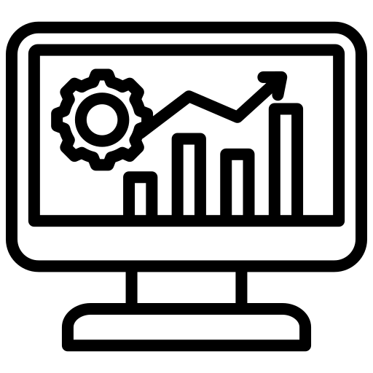
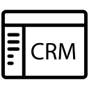

Sources of Big Data Generation
Business Systems
Business systems like Enterprise Resource Planning (ERP), Customer Relationship Management (CRM), accounting software, etc., generate a large amount of data. These systems record every transaction, every interaction with the customers, every financial transaction, etc.
ERP
CRM
Accounting
Notes:
Notes:
- Big Data Architecture involves organizing and integrating components, technologies, and processes for efficient collection, storage, processing, and analysis of large datasets, enabling organizations to leverage their data effectively.
- This architecture forms the basis for big data analytics, guiding data analytics efforts and offering an environment where tools extract crucial business insights from complex data.
- The architecture typically consists of four logical layers: sources, management & storage, analysis, and consumption, each performing specific processes.
For Students:
Big Data Architecture is like a system that helps organize and handle large amounts of data so that we can understand and use it better. It has different layers that help to collect, store, analyze, and present data in a way that helps companies make better decisions. It's like a big machine that turns lots of messy data into useful information.
Notes:
- The sources layer efficiently handles both batch and real-time processing of extensive data from various origins, including data warehouses, relational database management systems, SaaS, and IoT devices.
- The management & storage layer receives data from different sources, translates it into a format compatible with analytics tools, and stores it for effective analysis.
- The analysis layer utilizes various analytics tools to extract business intelligence from the stored data, while the consumption layer presents the results to the business intelligence layer for decision-making.
For Students:
Imagine the sources layer as a place where all kinds of data come from different places, like the internet or sensors. Then, the management & storage layer sorts out this data and stores it in a way that we can use it. Next, the analysis layer figures out what the data means and how it can help us. Finally, the consumption layer shows us the important information so we can make better choices.
Notes:
- Big Data Architecture typically includes components such as storage, processing, analysis, and visualization, each playing a vital role in managing and utilizing large volumes of data effectively.
For Students:
Big Data Architecture has different parts like a storage room, a place to sort and analyze the data, and a way to show us the results in pictures and graphs. Each part helps us understand and use the data in different ways.

Slide 21




Sources of Big Data Generation
Multimedia
Multimedia includes images, audio, video, documents, etc. Every file that is created, every video that is recorded, every document that is written generates data.
Images
Audio
Video
Documents
Notes:
**Detailed Notes - Big Data Ingestion**
*Case Study: Data Corp*
**Company Background:**
- Data Corp is a prominent player in the financial sector, serving millions of customers globally.
- With the surge in digital transactions, Data Corp faced a massive increase in unstructured data from various sources such as web logs, customer feedback, and transaction data.
**Challenges Faced:**
- Managing the exponential increase in data volume and its unstructured nature posed challenges in processing, analyzing, and extracting real-time insights.
- Traditional data handling tools were insufficient for the new age challenges in data management and analysis.
**Solution – Big Data Ingestion:**
- Mr. John Anderson initiated the integration of a Big Data Ingestion tool for real-time data processing and integration from various sources.
- The tool standardized and preprocessed vast amounts of unstructured and structured data, making it ready for analytics. Training sessions were also conducted to familiarize analysts with the new system.
**The Result:**
- Data Corp experienced a 70% reduction in data processing times and a 30% increase in customer satisfaction, along with a 20% rise in sales.
- Centralized and streamlined data facilitated accurate market trend predictions and customer behavior analysis, leading to the launch of three new financial products in just six months.
*For Students:*
Data Corp, a leading financial company, faced challenges in managing the surge of unstructured data. Implementing a Big Data Ingestion tool, they were able to process and analyze data in real-time, resulting in improved customer satisfaction and sales. The tool also enabled the company to predict market trends and launch new products efficiently.

Slide 22



Sources of Big Data Generation
Others
Extensive archives, transactions, and logs, etc. Sources of Big Data include archival emails, financial transaction data, server log files, and more.
Logs
Transactions
Archives
Notes:
- For Students: Big Data Architecture Overview encompasses the foundational structure for handling and analyzing large datasets efficiently.
- Big Data Architecture involves organizing and integrating components, technologies, and processes for efficient collection, storage, processing, and analysis of large datasets.
- It ensures smooth data flow, scalability, and optimal performance, enabling organizations to leverage their data effectively.
- Big data architecture serves as a comprehensive system to handle substantial data volumes for analysis, guiding data analytics efforts.
- The architecture blueprint defines the structure of big data infrastructures, outlining components, data flow, and security aspects, thus acting as a reference framework for designing effective big data solutions.
- The architecture components of big data analytics typically consist of four logical layers and perform four major processes: Sources Layer, Management & Storage Layer, Analysis Layer, and Consumption Layer.

Slide 23

QUIZ
Which of the following components are typically found in the architecture of Big Data systems?
Centralized Database Management Systems
Single-tier Architecture
Data Warehouses
Distributed File Systems
Answer: D
Explanation:
In Big Data architectures, distributed file systems play a crucial role in handling massive volumes of data. These file systems, such as Hadoop Distributed File System (HDFS), are designed to store and manage data across a cluster of machines. Unlike traditional centralized databases, distributed file systems are scalable, fault-tolerant, and can efficiently handle the storage and processing requirements of Big Data.
Notes:
Notes:
- Big Data Systems Architecture Components:
- Centralized Database Management Systems: Traditional databases that store data in a central location.
- Single-tier Architecture: A single-layer architecture system where all components are on a single platform.
- Data Warehouses: Central repositories for storing and managing structured data.
- Distributed File Systems: A system that distributes data across multiple machines for scalability and fault tolerance.
Summary:
Big Data systems architecture typically includes components such as centralized database management systems, single-tier architecture, data warehouses, and distributed file systems. Distributed file systems, such as Hadoop Distributed File System (HDFS), are particularly crucial in handling massive volumes of data in a scalable and fault-tolerant manner.
Key Points:
- Big Data systems architecture comprises various components to manage and process large volumes of data.
- Distributed file systems, like HDFS, are essential for scalable and fault-tolerant data storage and management in Big Data environments.
For Students:
In Big Data systems, distributed file systems, like Hadoop Distributed File System (HDFS), are used to efficiently store and manage large volumes of data across multiple machines, ensuring scalability and fault tolerance.

Slide 24
QUIZ
Which of the following are common sources of Big Data generation?
Printed Books
Online Transaction Records
Rotary Phones
Analog Thermometers
Answer: B
Explanation:
Online transaction records are one of the significant sources of Big Data generation. E-commerce platforms, financial institutions, and various online services generate massive amounts of transaction data daily.
Notes:
**For Students:**
Big Data Architecture refers to how organizations manage and analyze large volumes of data. It involves different layers and processes to handle data effectively, ensuring it can be stored, processed, analyzed, and presented in a useful manner.
- Big Data Architecture involves organizing and integrating components, technologies, and processes for efficient collection, storage, processing, and analysis of large datasets.
- It ensures smooth data flow, scalability, and optimal performance, enabling organizations to leverage their data effectively.
**Key Points:**
- Big Data Architecture forms the basis for big data analytics and guides data analytics efforts.
- It encompasses logical layers such as sources, management & storage, analysis, and consumption.
- The architecture includes components for storing, processing, analyzing, and visualizing data.
- It supports the efficient handling of various data sources, both in batch processing and real-time processing.

Slide 25
In a nutshell, we learnt
This module has covered two key areas. Firstly, we explored Big Data architecture components, including storage, processing, analysis, and visualization tools. Our architecture diagram illustrated the flow of data.
Secondly, we examined diverse sources of Big Data, ranging from web interactions and mobile activities to IoT devices and business systems. This foundation sets the stage for deeper exploration, enabling you to tap into the potential of Big Data for real-world impact.
Notes:
Summary:
- Explored Big Data architecture components: storage, processing, analysis, and visualization tools.
- Discussed the flow of data through an architecture diagram.
- Examined diverse sources of Big Data including web interactions, mobile activities, IoT devices, and business systems.
- Provides a foundation for understanding and leveraging the potential of Big Data for real-world impact.
Key Points:
- Explored components of Big Data architecture including storage, processing, analysis, and visualization tools.
- Analyzed the flow of data through an architecture diagram.
- Covered various sources of Big Data such as web interactions, mobile activities, IoT devices, and business systems.
- This foundation sets the stage for deeper exploration and understanding of the potential impact of Big Data in practical applications.

Slide 26
Introduction to Data Ingestion
• Introduction to Data Ingestion
• Batch vs Stream Data Ingestion
Notes:
The section provides an introduction to data ingestion and compares batch and stream data ingestion methods. It focuses on the process of bringing data into a system for processing and analysis, and explores the differences between batch and stream data ingestion techniques.

Slide 27
Big Data ingestion refers to the process of collecting, transferring, and loading large volumes of data from various sources into a storage or processing system, often for analysis and decision-making purposes. It involves handling data from diverse formats and sources, ensuring its accuracy, and preparing it for further processing.
What is Data Ingestion?
Notes:
- Data ingestion involves collecting, transferring, and loading large volumes of data from various sources into a storage or processing system for analysis and decision-making.
- It includes handling data from diverse formats and sources, ensuring its accuracy, and preparing it for further processing.
- Data ingestion is a critical step in the big data pipeline, enabling organizations to leverage data effectively for insights and decision-making.
For Students:
Data ingestion is like gathering a lot of different kinds of information from various places and making sure it’s all organized and ready to be used for important things like making decisions and finding patterns.

Slide 28

Data Ingestion
What is Data Ingestion?
Data ingestion is the crucial process of acquiring, validating, and processing data from a variety of sources.
It serves as the foundational step within a big data pipeline, setting the stage for subsequent processing and analysis.
Why is Data Ingestion Important?
Data ingestion is the critical first step in the journey of transforming raw data into valuable insights.
It ensures that data is efficiently moved from various sources into data lakes, data warehouses, or other storage systems.
Notes:
**For Students:**
Data ingestion is like gathering ingredients to cook a meal. It's the process of collecting and preparing data from different places so that we can use it to learn and make decisions. It's important because without this step, we can't analyze the data and find out valuable information.
- Data ingestion involves acquiring, validating, and processing data from various sources.
- It is the foundational step in the big data pipeline, preparing data for further processing and analysis.
- It ensures efficient movement of data from different sources into storage systems, like data lakes or data warehouses.

Slide 29
Key Functions of Data Ingestion
Processing
Routing
Gathering data from diverse sources such as databases, APIs, logs, sensors, and more.
Performing initial transformations like data cleaning, enrichment, and structuring.
Directing data to the correct destinations within the data architecture.
Acquisition
Validation
Storage
Verifying the integrity, quality, and consistency of the incoming data.
Storing ingested data in appropriate formats and structures for future analysis.
Notes:
Key Functions of Data Ingestion:
- Acquisition: Involves gathering data from various sources like databases, APIs, logs, and sensors.
- Validation: Verifying the integrity, quality, and consistency of the incoming data.
- Processing: Performing initial transformations such as data cleaning, enrichment, and structuring.
- Storage: Involves storing ingested data in suitable formats and structures for future analysis.
- Routing: Directing data to the correct destinations within the data architecture.
For Students:
Data ingestion is like collecting, checking, preparing, and storing data from different places so that it can be used for understanding and decision-making. It's like gathering puzzle pieces, making sure they fit, cleaning them, and putting them in the right box for later use.

Slide 30
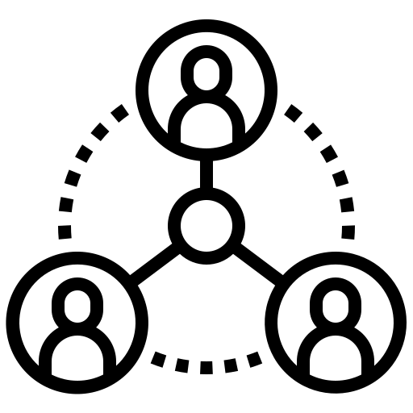

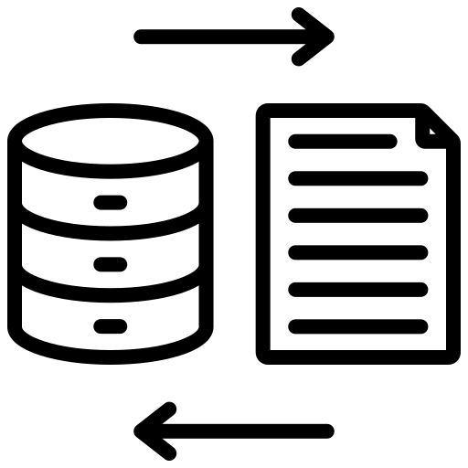
Data Ingestion Process Steps
1
Source Identification
Identifying the data sources that hold relevant information.
2
Connection Establishment
Creating connections or interfaces to extract data from the sources.
3
Data Extraction
Fetching data from sources using various methods (e.g., batch processing, real-time streaming).
4
Data Transformation
Converting raw data into a consistent format, handling missing values, and applying necessary encoding.
Notes:
For Students: Data Ingestion is like collecting and preparing ingredients before cooking. It involves getting data from different places, making sure it's accurate and organized, and then storing it properly for later use.
- **Data Ingestion**:
- Ingestion is the process of collecting, transferring, and loading large volumes of data from various sources into a storage or processing system.
- It handles data from diverse formats and sources, ensuring its accuracy and preparing it for further processing.
- **Importance of Data Ingestion**:
- It's the crucial first step in transforming raw data into valuable insights and sets the stage for subsequent processing and analysis.
- It ensures that data is efficiently moved from various sources into data lakes, data warehouses, or other storage systems.
- **Key Functions of Data Ingestion**:
- Acquisition: Gathering data from diverse sources such as databases, APIs, logs, sensors, etc.
- Validation: Verifying the integrity, quality, and consistency of the incoming data.
- Processing: Performing initial transformations like data cleaning, enrichment, and structuring.
- Storage: Storing ingested data in appropriate formats and structures for future analysis.
- Routing: Directing data to the correct destinations within the data architecture.
- **Data Ingestion Process Steps**:
- Source Identification: Identifying the data sources that hold relevant information.
- Connection Establishment: Creating connections or interfaces to extract data from the sources.
- Data Extraction: Fetching data from sources using various methods (e.g., batch processing, real-time streaming).
- Data Transformation: Converting raw data into a consistent format, handling missing values, and applying necessary encoding.

Slide 31




Data Ingestion Process Steps
5
Data Loading
Storing transformed data in data lakes, warehouses, or other storage solutions.
6
Validation and Error Handling
Ensuring data accuracy and handling errors that may occur during the ingestion process.
7
Metadata Management
Adding metadata to the ingested data to provide context for downstream processing.
8
Notification and Monitoring
Alerting stakeholders about successful or failed data ingestion. Monitoring system performance.
Notes:
### Detailed Notes:
#### Introduction to Data Ingestion:
- Data ingestion is the process of collecting, transferring, and loading large volumes of data from various sources into a storage or processing system for analysis and decision-making purposes.
- It involves handling data from diverse formats and sources, ensuring its accuracy, and preparing it for further processing.
#### Key Functions of Data Ingestion:
- Acquisition: Gathering data from diverse sources such as databases, APIs, logs, sensors, etc.
- Validation: Verifying the integrity, quality, and consistency of the incoming data.
- Processing: Performing initial transformations like data cleaning, enrichment, and structuring.
- Storage: Storing ingested data in appropriate formats and structures for future analysis.
- Routing: Directing data to the correct destinations within the data architecture.
#### Data Ingestion Process Steps:
1. Source Identification: Identifying the data sources that hold relevant information.
2. Connection Establishment: Creating connections or interfaces to extract data from the sources.
3. Data Extraction: Fetching data from sources using various methods (e.g., batch processing, real-time streaming).
4. Data Transformation: Converting raw data into a consistent format, handling missing values, and applying necessary encoding.
5. Data Loading: Storing transformed data in data lakes, warehouses, or other storage solutions.
6. Validation and Error Handling: Ensuring data accuracy and handling errors that may occur during the ingestion process.
7. Metadata Management: Adding metadata to the ingested data to provide context for downstream processing.
8. Notification and Monitoring: Alerting stakeholders about successful or failed data ingestion. Monitoring system performance.
#### For Students:
Data ingestion is like gathering information from different places, verifying its accuracy, organizing it, and storing it in a way that makes it easy to use. It's similar to collecting puzzle pieces, checking if they fit, arranging them, and then putting them in the right boxes.
### Summary:
This section provides an understanding of data ingestion, its key functions, and the process steps involved in collecting, processing, and storing data from various sources for analysis.
These notes cover the fundamental concepts of data ingestion, its importance, functions, and the sequential steps involved in the data ingestion process.
For students, the explanation simplifies the process of data ingestion, making it easy to understand how data is collected, verified, organized, and stored for further use.

Slide 32
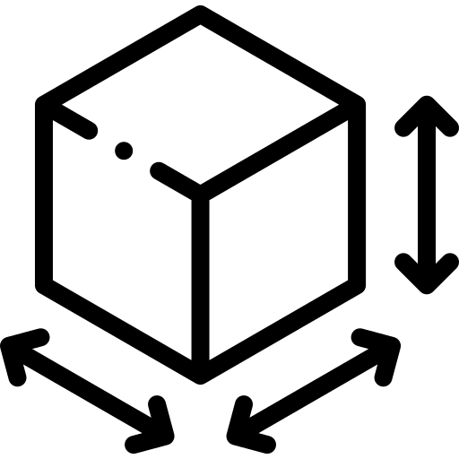

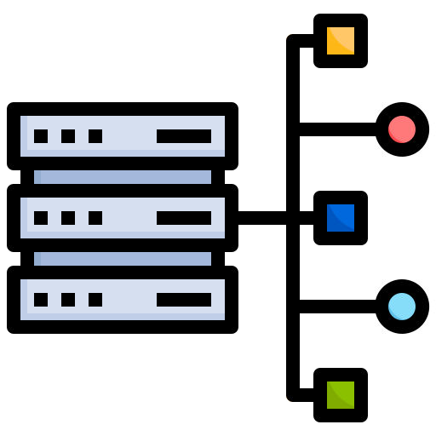


Challenges in Data Ingestion
Volume and Velocity
Latency
Data Variety
Scalability
Data Quality
Notes:
**Detailed Notes:**
- **Introduction to Big Data Ingestion:**
- Big Data Ingestion involves the process of collecting, transferring, and loading large volumes of data from various sources into a storage or processing system for analysis and decision-making purposes.
- **Key Functions of Data Ingestion:**
- Acquisition: Gathering data from diverse sources such as databases, APIs, logs, sensors, etc.
- Validation: Verifying the integrity, quality, and consistency of the incoming data.
- Processing: Performing initial data transformations like cleaning, enrichment, and structuring.
- Storage: Storing ingested data in appropriate formats and structures for future analysis.
- Routing: Directing data to the correct destinations within the data architecture.
- **Data Ingestion Process Steps:**
- Source Identification: Identifying the data sources that hold relevant information.
- Connection Establishment: Creating connections or interfaces to extract data from the sources.
- Data Extraction: Fetching data from sources using various methods (e.g., batch processing, real-time streaming).
- Data Transformation: Converting raw data into a consistent format, handling missing values, and applying necessary encoding.
- Data Loading: Storing transformed data in data lakes, warehouses, or other storage solutions.
- Validation and Error Handling: Ensuring data accuracy and handling errors that may occur during the ingestion process.
- Metadata Management: Adding metadata to the ingested data to provide context for downstream processing.
- Notification and Monitoring: Alerting stakeholders about successful or failed data ingestion. Monitoring system performance.
- **Challenges in Data Ingestion:**
- Volume and Velocity: Managing the high volume and velocity of incoming data.
- Data Variety: Handling diverse data types and formats.
- Data Quality: Ensuring the accuracy, completeness, and reliability of the ingested data.
- Scalability: Adapting to accommodate increasing data volumes and user demands.
- Latency: Minimizing delays in data processing and analysis.
**For Students:**
Data ingestion is the process of collecting and preparing large amounts of data for analysis. It involves gathering data from different sources, ensuring its accuracy, and organizing it for further processing. Challenges in data ingestion include managing the high volume and speed of incoming data, handling diverse data types, ensuring data quality, adapting to increasing data volumes, and minimizing delays in data processing.

Slide 33

Batch vs Stream Data Ingestion
Batch Data Ingestion
Stream Data Ingestion
Latency
Batch data ingestion has higher latency due to processing intervals.
Stream data ingestion offers lower latency since data is processed immediately upon arrival
Timeliness
Batch data ingestion is more suited for historical analysis and reports.
Stream data ingestion is suitable for applications requiring timely insights and actions.
Complexity
Batch data ingestion systems are generally simpler.
Stream data ingestion systems tend to be more complex to set up due to the need for real-time processing and handling potential data spikes.
Scalability
Batch data ingestion may struggle with very high data volumes.
Stream data ingestion can handle high-velocity data streams, making it well-suited for scenarios with rapidly changing data.
Infrastructure
Batch data ingestion typically requires tools for batch processing and data warehousing.
Stream data ingestion often requires specialized infrastructure and tools to handle data in motion.
Notes:
**Summary:**
This module covers Big Data Ingestion and its significance in managing large volumes of data for analysis and decision-making. It explores the components of Big Data architecture, sources of Big Data, and the implications of data ingestion in real-world scenarios.
**Key Points:**
- Big Data Ingestion involves collecting, transferring, and loading large volumes of data from diverse sources to storage or processing systems.
- Big Data Architecture components include storage, processing, analysis, and visualization tools, while sources of Big Data range from web interactions, mobile activities, IoT devices, business systems, multimedia, to extensive archives and logs.
- Data Ingestion is crucial for acquiring, validating, and processing data, ensuring its accuracy and preparing it for further processing.
- The key functions of Data Ingestion include acquisition, validation, processing, storage, and routing.
- The Data Ingestion process involves source identification, connection establishment, data extraction, transformation, loading, validation, error handling, metadata management, and notification and monitoring.
- Challenges in Data Ingestion include volume and velocity, data variety, data quality, scalability, and latency.
- Batch Data Ingestion has higher latency and is suitable for historical analysis, while Stream Data Ingestion offers lower latency and is ideal for applications requiring timely insights and actions.
**For Students:**
Big Data Ingestion involves collecting and organizing large volumes of data for analysis. It's important for ensuring data accuracy and preparing it for further processing. The process includes steps such as identifying data sources, extracting and transforming data, and storing it for analysis. Challenges include handling different types of data, ensuring data quality, and managing high data volumes. Batch ingestion is suited for historical analysis, while streaming ingestion is more suitable for real-time insights and actions.

Slide 34

Batch vs Stream Data Ingestion
Examples
Batch Data Ingestion
Daily Website Logs:
Collecting logs from a website over a 24-hour period and processing them in a batch at the end of the day. Useful for generating daily traffic reports and analyzing trends over time.
Customer Transaction Logs:
Collecting a day's worth of customer transactions and processing them in a batch overnight. Ideal for generating financial reports and reconciling accounts
Notes:
For Students:
Batch data ingestion is like collecting data over a period and analyzing it at once, like gathering logs from a website for a whole day to see daily traffic trends. It's useful for historical analysis and reports.
Stream data ingestion is like processing data as it comes in, such as real-time processing of customer transactions for immediate insights. It's suitable for scenarios requiring timely actions and insights.
- Batch Data Ingestion Examples:
- Daily Website Logs: Collecting logs from a website over a day and processing them at the end of the day for daily traffic reports.
- Customer Transaction Logs: Collecting a day's worth of customer transactions and processing them overnight for financial reports.

Slide 35

Batch vs Stream Data Ingestion
Examples
Stream Data Ingestion
User Clicks:
Processing user clicks on a website as they happen in real time. Useful for immediate analysis of user behavior and optimizing web content.
IoT Sensor Data:
Collecting data from sensors on industrial equipment as it's generated. Allows for real-time monitoring of equipment health and predicting maintenance needs.
Notes:
**Summary:**
- The module discusses Big Data architecture components, including storage, processing, analysis, and visualization tools, and explores diverse sources of Big Data to tap into its potential for real-world impact.
**Key Points:**
- Explored Big Data architecture components, including storage, processing, analysis, and visualization tools.
- Examined diverse sources of Big Data, such as web interactions, mobile activities, IoT devices, and business systems.
**For Students:**
This module covers the structure of Big Data systems and the different sources of Big Data, giving us an understanding of how to effectively manage and utilize large volumes of data for analysis and decision-making.

Slide 36
QUIZ
What is the primary purpose of data ingestion in the context of data processing?
Data ingestion is solely responsible for data storage.
Data ingestion involves transforming data for reporting purposes.
Data ingestion prepares data for further processing and analysis.
Data ingestion focuses on data visualization and dashboard creation.
Answer: C
Explanation:
Data ingestion involves the process of collecting and importing data from various sources into a data storage system. Its primary purpose is to prepare the collected data for further processing, analysis, and storage.
Notes:
Summary:
- Data ingestion is the process of collecting, transferring, and loading large volumes of data from various sources into a storage or processing system for analysis and decision-making purposes.
- It is the foundational step in a big data pipeline, setting the stage for subsequent processing and analysis.
- Key functions include acquisition, validation, processing, storage, and routing of data from diverse sources such as databases, APIs, logs, sensors, and more.
- The data ingestion process involves source identification, connection establishment, data extraction, transformation, loading, validation, error handling, metadata management, and notification and monitoring.
- Challenges in data ingestion include volume and velocity, data variety, data quality, scalability, and latency.
- Batch data ingestion has higher latency and is suitable for historical analysis, while stream data ingestion offers lower latency and is suitable for applications requiring timely insights and actions.
- Examples of batch and stream data ingestion include daily website logs and customer transaction logs for batch ingestion, and user clicks and IoT sensor data for stream ingestion.
- The primary purpose of data ingestion is to prepare collected data for further processing, analysis, and storage.
For Students:
Data ingestion is like gathering, organizing, and preparing a jumble of information from different places so that it can be better understood and used for making decisions. It's like getting all your puzzle pieces ready before you start putting the puzzle together.

Slide 37
QUIZ
What is a key difference between batch data ingestion and stream data ingestion?
A. Batch ingestion processes data in fixed-size chunks and is suitable for historical data analysis.
B. Stream ingestion processes data in real-time as it arrives.
C. Batch ingestion is ideal for low-latency processing.
D. Stream ingestion deals with data in large, time-bound chunks.
Answer: B
Explanation:
Batch data ingestion processes data in chunks over a period, while stream data ingestion deals with data in real-time as it arrives, making it suitable for immediate processing and analysis.
Notes:
Summary:
- Big Data Ingestion refers to the process of collecting, transferring, and loading large volumes of data from various sources into a storage or processing system for analysis and decision-making purposes.
- Key functions of data ingestion include acquisition, validation, processing, storage, and routing.
- The data ingestion process involves source identification, connection establishment, data extraction, data transformation, data loading, validation and error handling, metadata management, and notification and monitoring.
- Challenges in data ingestion include volume and velocity, data variety, data quality, scalability, and latency.
- Batch data ingestion has higher latency due to processing intervals, whereas stream data ingestion offers lower latency since data is processed immediately upon arrival.
- Examples of batch data ingestion include daily website logs and customer transaction logs, while examples of stream data ingestion include user clicks and IoT sensor data.
For Students:
Data ingestion is like collecting data from different places and getting it ready for use, like cleaning and organizing your room before doing your homework. This process is important for making sure the data is accurate and useful. Batch data ingestion is like doing your homework after collecting all the information, while stream data ingestion is like doing your homework as you receive new information, allowing you to work on it immediately.

Slide 38
In a nutshell, we learnt
Data ingestion involves acquiring, validating, and processing data from various sources.
It's a critical initial step in the big data pipeline.
Data is moved from sources into data lakes or warehouses.
Batch ingestion handles large data volumes collected over time, loaded in batches.
Stream ingestion deals with continuous real-time data, loaded incrementally.
Notes:
Summary:
- Data ingestion involves acquiring, validating, and processing data from various sources, serving as an initial step in the big data pipeline.
- It involves moving data from sources into data lakes or warehouses for further processing and analysis.
- Batch ingestion handles large data volumes collected over time, loaded in batches for historical analysis and reporting.
- Stream ingestion processes continuous real-time data incrementally, suitable for immediate processing and analysis.
Key Points:
- Data ingestion is a critical step in the big data pipeline, involving the acquisition, validation, and processing of data from various sources.
- It facilitates the movement of data into storage systems like data lakes or warehouses.
- Batch ingestion handles large data volumes collected over time, ideal for historical analysis and reporting.
- Stream ingestion processes continuous real-time data incrementally, suitable for immediate processing and analysis.

Slide 39
Data Ingestion Pipeline
Data Ingestion Pipeline
ETL vs ELT
Key Factors for Data Ingestion Pipeline
Notes:
**Notes:**
- Data Ingestion Pipeline refers to the process of collecting, transferring, and processing large volumes of data from diverse sources into a storage or processing system for analysis and decision-making purposes.
- It involves preparing data for further processing and analysis, ensuring accuracy and consistency.
- The pipeline encompasses stages such as extraction, transformation, and loading (ETL), or extraction, loading, and transformation (ELT).
- Key factors include scalability, data integrity, automation, security, and real-time processing capabilities.
- Data Ingestion Pipeline is crucial for organizations seeking to harness valuable insights from their data and make informed decisions.
**For Students:**
Imagine a pipeline that collects, cleans, and prepares different types of data from various sources like databases, logs, and sensors. This pipeline ensures the data is ready for analysis and decision-making, similar to how water flows through a pipe to reach its destination.

Slide 40
Data ingestion pipeline is a series of steps and tools used to collect, validate, transform, and load data from various sources into a database, data warehouse, or data lake. This process ensures the data is clean, consistent, and readily available for analysis or other applications.
Data Ingestion Pipeline
Notes:
For Students:
Data ingestion pipeline is like a conveyor belt that collects, checks, changes, and stores data from different places into a big storage area. This makes sure the data is neat, reliable, and ready for analysis.
- Data ingestion pipeline: A sequence of steps and tools for collecting, validating, transforming, and loading data into a storage system.
- Purpose: Ensures data cleanliness, consistency, and accessibility for analysis or other uses.
- Components: Series of processes and technologies that handle the data flow from its sources to storage.
- Importance: Enables organizations to efficiently manage and utilize large volumes of diverse data.
- Key goal: To streamline the process of acquiring and preparing data for further use.

Slide 41

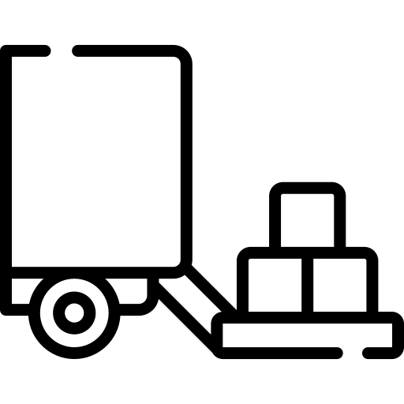

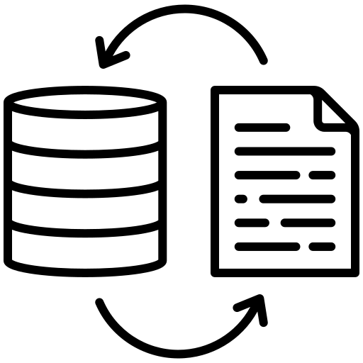
Data Ingestion Pipeline
This process often involves several steps to move data from the source to the destination. Here are the common steps involved in a data ingestion pipeline:
Data Extraction
Data Validation
Data Transformation
Data Loading
Metadata Management
Source Identification
Data Retrieval
Quality Check
Data Cleaning
Data Formatting
Data Enrichment
Data Aggregation
Data Import
Data Indexing
Metadata Collection
Metadata Storage
Metadata Usage
Notes:
**Summary:**
- Data ingestion pipeline refers to the process of collecting, validating, transforming, and loading data from diverse sources into a storage system for analysis or further applications.
**Key Points:**
- Data ingestion pipeline involves a series of steps and tools to ensure data is clean, consistent, and accessible for analysis.
- The pipeline encompasses numerous steps such as metadata collection, storage, and usage, data import, indexing, loading, formatting, enrichment, aggregation, transformation, quality check, cleaning, validation, source identification, and extraction.
**For Students:**
The data ingestion pipeline is like a series of steps that help gather, organize, and prepare data from different places so that it's ready for us to study and learn from. It involves various tasks such as checking the data, making sure it's tidy, and putting it in a format that's easy for us to understand and use.

Slide 42

Data Ingestion Pipeline
Data Extraction: is the first step in the data ingestion pipeline
Source Identification
This is the initial stage where you identify the sources from which you need to extract data. Data sources can be various types like databases, flat files, apis, web pages, or data streams.
Data Retrieval
This involves connecting to the source, querying the source for data, and then collecting the data. For example, if the source is a database, you would connect to the database and run a SQL query to retrieve the data. If the source is an API, you would make a request to the API and collect the response data.
Notes:
**Summary:**
- Data ingestion involves acquiring, validating, and processing data from various sources, serving as a critical initial step in the big data pipeline.
- The data ingestion pipeline is a series of steps and tools used to collect, validate, transform, and load data from various sources into a database, data warehouse, or data lake.
- The process often involves several steps, including metadata collection, storage, and usage, data import, indexing, loading, formatting, enrichment, aggregation, transformation, quality checks, cleaning, validation, source identification, data retrieval, and extraction.
**Key Points:**
- Data ingestion is a critical initial step in the big data pipeline, involving the acquisition, validation, and processing of data from various sources.
- The data ingestion pipeline comprises a series of steps and tools to collect, validate, transform, and load data into a database, data warehouse, or data lake.
- Common steps in a data ingestion pipeline include metadata collection, storage, usage, management, data import, indexing, loading, formatting, enrichment, aggregation, transformation, quality checks, cleaning, validation, source identification, data retrieval, and extraction.
**For Students:**
In simple terms, the data ingestion pipeline is like a series of steps and tools used to gather, organize, and prepare data from different places so that it can be used for analysis or other applications. It involves various tasks like collecting information about the data, storing it, checking its quality, cleaning and organizing it, and making sure it's ready for use. The data extraction, which is the first step, is like pulling the data from its original sources and getting it ready for the next steps.

Slide 43

Data Ingestion Pipeline
Data Validation: is a critical step in the data ingestion pipeline. It involves two main sub-steps
Quality Check
This involves assessing the data to ensure it is complete, accurate, and up-to-date. Various quality checks could be performed
Data Cleaning
This involves correcting or removing any inaccuracies or inconsistencies identified during the quality check. Common data cleaning tasks include.
Removing Duplicates
Filling Missing Values
Correcting Errors
Standardizing Data
Notes:
For Students:
Data Ingestion:
Data ingestion is like collecting, organizing, and preparing a lot of information from different places, so it's ready for us to look at and use.
Data Ingestion Pipeline:
It's a bit like a conveyor belt that moves the information from where it's stored to where we can use it. It has different steps to make sure the information is clean and ready for us to work with.
Data Extraction:
This is like taking the information from its original place and getting it ready to be moved along the conveyor belt.
Data Validation:
This is checking that the information is correct and making sure it's ready for the next steps in the process.
I hope that helps! Let me know if you have any other questions or need further explanations.

Slide 44
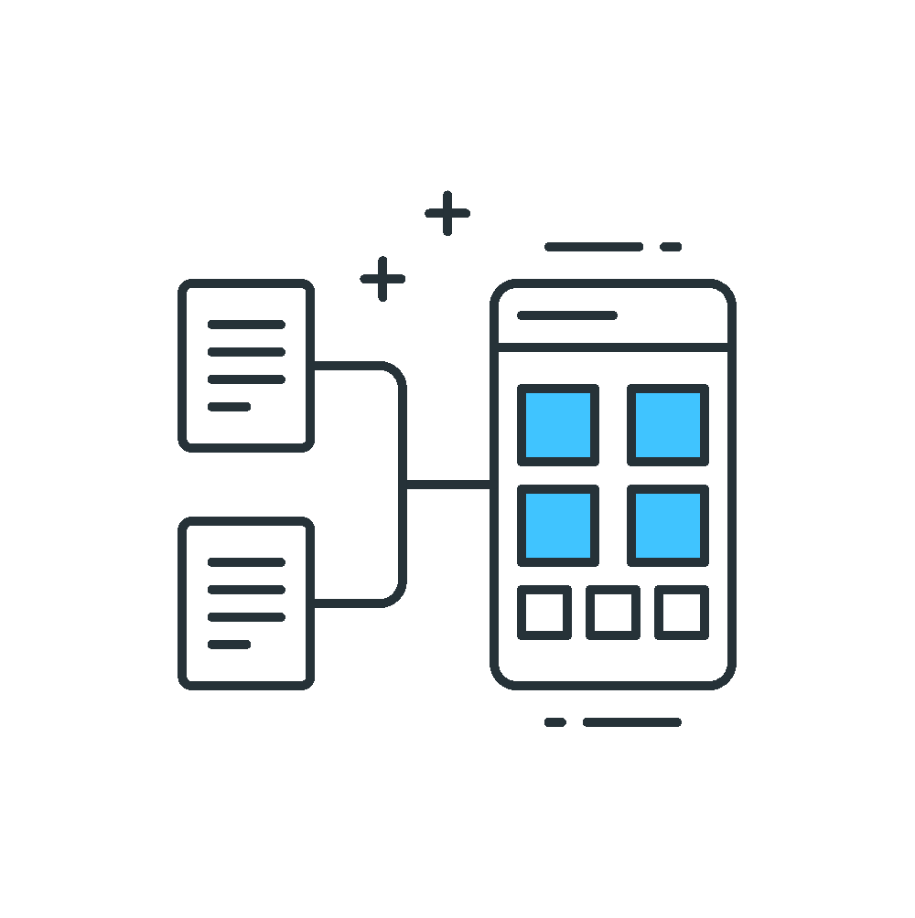
Data Ingestion Pipeline
Data Transformation: the data is cleaned and converted into a format that can be easily analyzed or used by other applications. It typically involves the following sub-steps
Data Formatting
Converting data into a common format or structure suitable for the target destination or application.
Data Enrichment
Enhancing data by adding more information or context, combining with other data sources, or performing calculations to generate new information
Data Aggregation
Combining data from various sources or grouping data based on certain criteria, and performing aggregation operations like sum, average, etc.
Notes:
For Students:
Data Ingestion refers to the process of collecting, verifying, and preparing data from various sources for analysis and decision-making. It's like gathering, checking, and organizing information for future use, making it easier to understand and work with.
Data Ingestion Pipeline:
- It involves a series of steps and tools used to collect, validate, transform, and load data into a database, data warehouse, or data lake.
- The pipeline ensures that the data is clean, consistent, and readily available for analysis or other applications.
Steps Involved in a Data Ingestion Pipeline:
- Metadata Collection, Storage, Usage, and Management
- Data Import, Indexing, Loading, and Formatting
- Data Enrichment, Aggregation, and Transformation
- Quality Check, Cleaning, and Validation
- Source Identification, Retrieval, and Extraction
These steps help in systematically moving data from its source to its destination, ensuring it is reliable and ready for analysis or usage.
Data Extraction: The first step in the data ingestion pipeline involves retrieving data from its source.
Data Validation: A critical step in the data ingestion process, it ensures the integrity, accuracy, and consistency of the incoming data.
Data Transformation: Involves cleaning and converting data into a format that can be easily analyzed or used by other applications.
These steps are crucial in ensuring that the data is accurate, consistent, and ready for further analysis or processing.

Slide 45
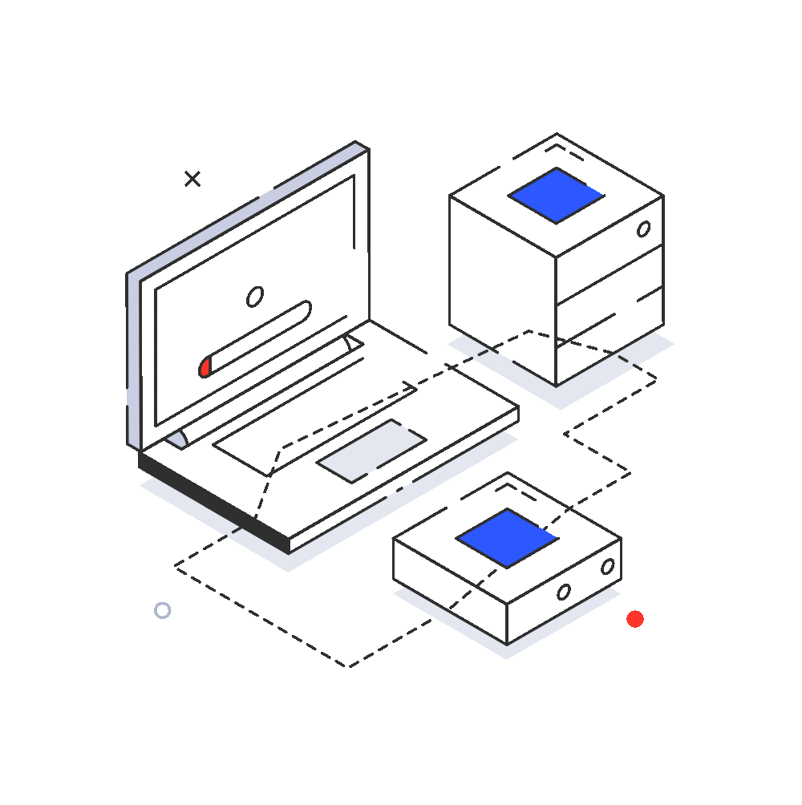
Data Ingestion Pipeline
Data Loading: is the process of moving the prepared and transformed data into a target destination such as a database, data warehouse, or a data lake.
Data Import
Moving transformed data into the target system.
Can be done in batches or real-time.
Important to maintain data integrity and system performance.
Data Indexing
Creating indexes on frequently queried columns or fields.
Helps in efficient data retrieval.
Type of indexing depends on the nature of data and target system.
Notes:
For Students:
Data Ingestion Pipeline is like a series of steps used to clean, organize, and move data from different places into a big storage system. It's like making sure all the information is tidy and ready for use.
- Metadata Collection: Gathering information about the data.
- Data Import: Bringing the data into the storage system.
- Data Transformation: Cleaning and changing the data into a useful format.
- Data Loading: Putting the data into its new home.
These steps help make sure we can use the data for things like reports or finding out interesting information.

Slide 46
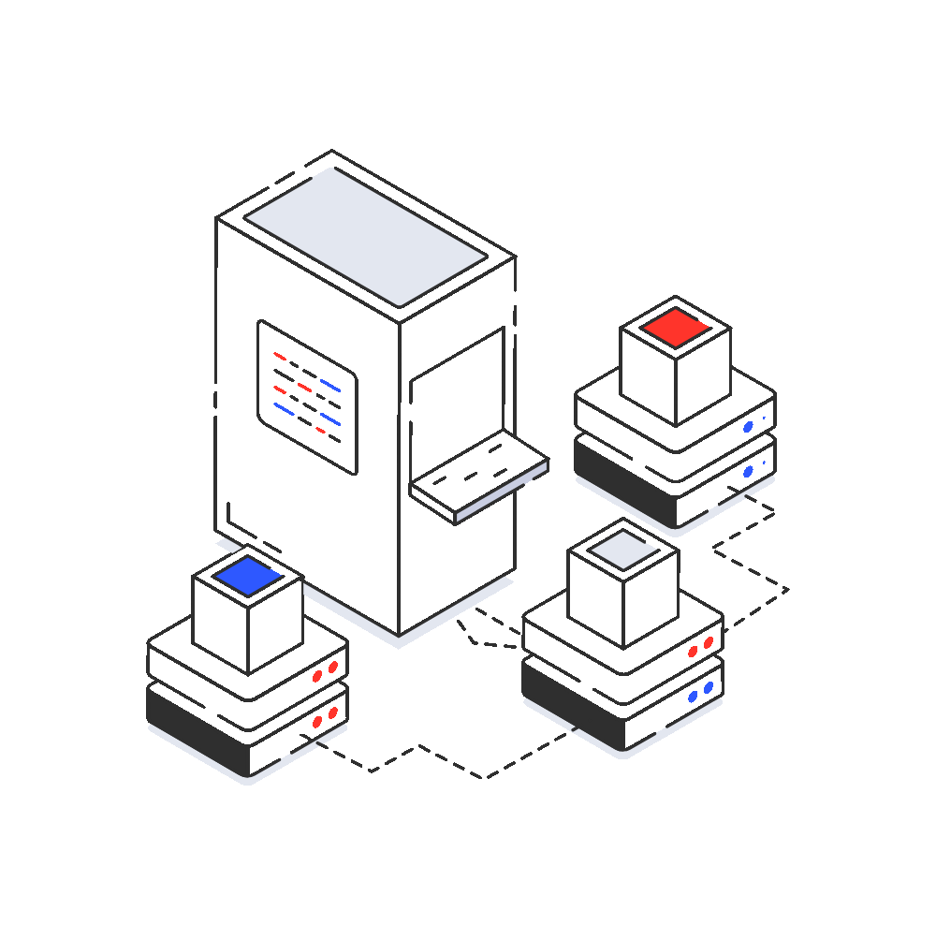
Data Ingestion Pipeline
Metadata Management: Metadata management is the process of collecting, storing, and using metadata to make data more organized, useful, and accessible.
Metadata Collection
Gathering metadata from various sources, which can include information about the data source, type, format, transformations applied, and collection time.
Metadata Storage
Storing the collected metadata in a structured and organized manner, often in a metadata repository like a database, file system, or specialized system.
Metadata Usage
Metadata usage involves utilizing the collected and stored metadata for data lineage, cataloging, governance, and integration.
Notes:
Summary:
The Data Ingestion Pipeline involves a series of steps and tools to collect, validate, transform, and load data into storage systems. It ensures data is clean, consistent, and readily available for analysis. The pipeline includes steps such as metadata collection, data extraction, validation, transformation, loading, and metadata management.
Key Points:
- The Data Ingestion Pipeline is a critical process for collecting, validating, transforming, and loading data from various sources into storage systems.
- Steps in the pipeline include metadata collection, data extraction, validation, transformation, loading, and metadata management.
- Each step in the pipeline serves a specific purpose, from gathering metadata to preparing and loading the data into storage systems.
- The pipeline ensures that data is organized, clean, and accessible for analysis and decision-making.
- Metadata management is an essential aspect of the pipeline, involving the collection, storage, and usage of metadata to make data more organized, useful, and accessible.
For Students:
The data ingestion pipeline is like a series of steps that help us collect, clean, and organize data from different sources so that we can use it for analysis. It's like putting together puzzle pieces to create a clear picture of the data. Each step in the pipeline has a specific job to make sure the data is ready for us to use and understand. It's important because it helps us work with data effectively and make good decisions based on the information we gather.

Slide 47
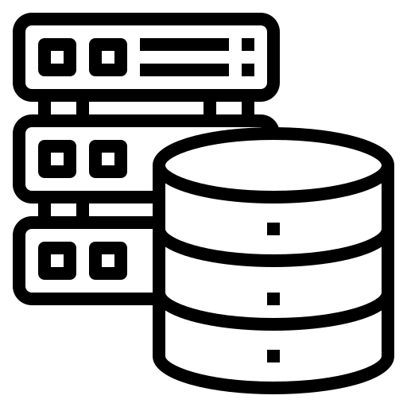
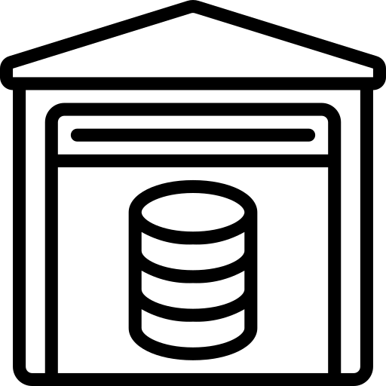
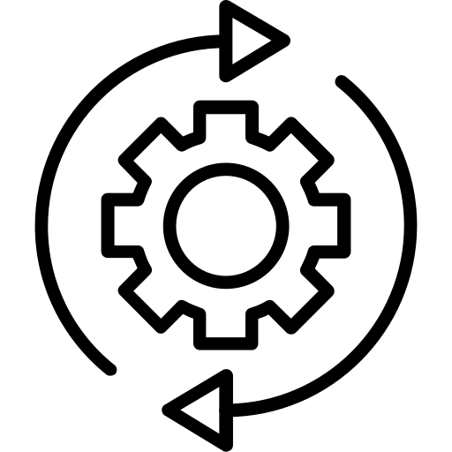


ETL vs ELT
Extract
Transform
Load
Extract
Load
Transform
Notes:
ETL vs ELT:
ETL (Extract, Transform, Load):
- Involves extracting data from source systems, transforming it into a suitable format, and then loading it into a target system.
- Data is transformed before loading into the target system, often using a dedicated ETL tool.
- Suitable for batch processing and is commonly associated with traditional data warehousing.
ELT (Extract, Load, Transform):
- Involves extracting data from source systems, loading it into a target system, and then transforming it as needed within the target system.
- Data is loaded into the target system first and then transformed using the processing power of the target system.
- Suited for big data and real-time analytics, particularly in scenarios with large data volumes and complex data processing needs.
For Students:
ETL involves transforming data before loading it into the target system, while ELT loads data into the target system first and then transforms it. ETL is suitable for traditional data warehousing, while ELT is better for big data and real-time analytics with large data volumes and complex processing needs.

Slide 48
ETL vs ELT
ETL
ELT
Order of Operations
Extract -> Transform -> Load
Extract -> Load -> Transform
Processing
Location
Transformation occurs before loading, typically in a separate staging area or tool.
Transformation occurs after loading, directly in the target data warehouse or database.
Complexity and Processing Time
More time-consuming and complex due to pre-loading transformation.
Faster and less complex as transformation is done post-loading using the target system's computational power.
Tools
Traditional ETL tools like Informatica, Talend, SSIS.
Modern data warehouse platforms like Amazon Redshift, Google BigQuery, Snowflake, or traditional ETL tools configured for ELT.
Scalability
Limited by the capacity of the transformation server/tool.
Higher scalability leveraging the power of the target system.
Data Storage
Temporary storage needed for intermediate data.
No additional storage needed as data is loaded directly into the target system.
Flexibility
Fixed transformation logic; changes require modifying the ETL process.
More flexible transformation logic; can be modified or extended in the target system without changing the initial load process.
Cost
Additional costs for separate transformation servers/tools.
more cost-effective as it leverages the existing computational power of the target system.
Notes:
For Students:
"ETL vs ELT" refers to the methods used to process and load data into a database or data warehouse.
- ETL follows the sequence of Extract, Transform, and Load, where data is transformed before loading into the target system, often requiring separate tools for transformation.
- ELT follows the sequence of Extract, Load, and Transform, where data is loaded into the target system before transformation, leveraging the system's computational power for faster processing.
- ETL tools include Informatica, Talend, and SSIS, while ELT uses modern data warehouse platforms like Amazon Redshift, Google BigQuery, and Snowflake, or traditional ETL tools configured for ELT.
- ETL is more complex and time-consuming due to pre-loading transformation, while ELT is faster and less complex as transformation occurs post-loading.
- ETL requires temporary storage for intermediate data and additional costs for separate transformation servers/tools, while ELT does not require additional storage and is more cost-effective, leveraging the existing computational power of the target system.
These methods determine the order and process for transforming and loading data, impacting the efficiency and cost of the data processing and storage.

Slide 49

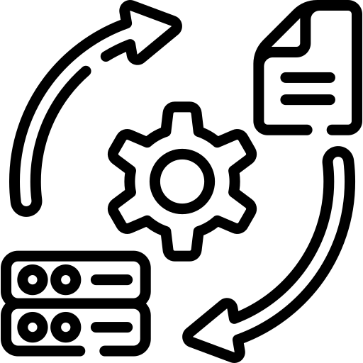
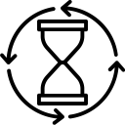
Key Factors for Data Ingestion Pipeline
Data sources and volumes:
Identify where the data is coming from, such as databases, streams, or files, and estimate the size or volume to handle. This helps in designing an efficient ingestion mechanism.
Transformation needed:
Determine any data manipulation, cleaning, or enrichment required before the data lands in its destination. This can influence the choice of tools and the design of the pipeline.
Loading frequency:
Understand how often data needs to be loaded - be it in real-time, batch, or micro-batch modes. This factor directly affects the pipeline's architecture and resource allocation.
Notes:
Key Factors for Data Ingestion Pipeline:
Efficiency: The pipeline should efficiently collect, validate, transform, and load data from diverse sources.
Scalability: The system should be able to handle increasing data volumes without compromising performance.
Reliability: The pipeline should ensure the accuracy and consistency of the data being ingested.
Flexibility: The pipeline should be adaptable to accommodate different data formats and types from various sources.
Real-time Processing: Capability to process and load data in real-time to enable immediate analysis and actions.
Metadata Management: Effective collection, storage, and utilization of metadata for enhanced data organization and accessibility.
Cost-effectiveness: The pipeline should be cost-efficient with the ability to leverage existing resources and minimize additional costs.
For Students:
The factors to consider when designing a data ingestion pipeline include making sure it efficiently handles various types of data, can handle increasing amounts of data, ensures data accuracy, is adaptable, can process data in real-time, efficiently manages metadata, and is cost-effective.

Slide 50


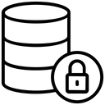
Key Factors for Data Ingestion Pipeline
Target systems:
Identify the final destinations like data lakes, databases, or data warehouses. Knowing the target system informs decisions about compatibility and data formats.
Latency requirements:
Ascertain the time window within which data should be made available in the target system. Real-time analytics will demand lower latency compared to periodic reporting.
Data security:
Ensure that the data in transit and at rest is protected, considering encryption, masking, and access controls. Data compliance and privacy standards like GDPR or CCPA may also apply.
Notes:
Key Factors for Data Ingestion Pipeline:
- Scalability: The pipeline should be able to handle growing data volumes without compromising performance.
- Data Quality: Ensuring high-quality data is ingested, validated, and processed for accuracy and consistency.
- Flexibility: The pipeline should support various data formats, structures, and sources, adapting to changing requirements.
- Real-time Capabilities: Ability to ingest and process real-time streaming data for timely insights and actions.
- Metadata Management: Effective collection, storage, and usage of metadata to enhance data organization and accessibility.
- Security: Implementing robust security measures to protect data during the ingestion process.
- Monitoring and Alerting: Proactive monitoring of the pipeline's performance and the ability to alert stakeholders about successful or failed data ingestion.
- Transformation and Enrichment: Incorporating capabilities for data transformation, enrichment, and aggregation to prepare data for analysis and other applications.
For Students:
These are the important aspects to consider when setting up the process to bring data from various sources into a centralized system. It's crucial to ensure that the process can handle large amounts of data, maintain its quality, adapt to different data types, process real-time data, manage metadata effectively, secure the data, monitor the process, and prepare the data for analysis.

Slide 51



Key Factors for Data Ingestion Pipeline
Error handling:
Plan for potential disruptions or data anomalies. Determine how the system should respond, whether by retrying, logging errors, or diverting problematic records for review.
Scalability:
Anticipate future data growth. The ingestion infrastructure should scale either vertically or horizontally to accommodate increasing data loads without performance degradation.
Monitoring and alerts:
Implement tracking to ensure the pipeline's health, with proactive notifications for any disruptions or failures. This ensures timely intervention and reduces downtime.
Notes:
Key Factors for Data Ingestion Pipeline:
- Scalability: The data ingestion pipeline should be able to handle large volumes of data and scale in response to changing data demands.
- Data Quality: Ensure that the data ingested is accurate, consistent, and meets quality standards to avoid errors in downstream processes.
- Data Security: Implement measures to ensure the security and privacy of the ingested data, adhering to compliance and data protection regulations.
- Real-time Processing: The pipeline should support real-time data ingestion and processing for timely insights and actions.
- Integration Capabilities: Ability to integrate with various data sources, applications, and systems to collect data from diverse platforms.
- Monitoring and Alerting: Implement monitoring tools to track the performance of the ingestion process and receive alerts for any issues or failures.
- Metadata Management: Collect, store, and utilize metadata to provide context and lineage for the ingested data.
- Error Handling: Implement mechanisms to handle and manage errors that may occur during the data ingestion process.
- Flexibility: The pipeline should be flexible enough to adapt to changing data requirements and accommodate new data sources.
For Students:
Data ingestion pipeline factors are important aspects to ensure that the data collection and processing are efficient, secure, and adaptable to changing data needs. It involves scalability, data quality, security, real-time processing, integration capabilities, monitoring, metadata management, error handling, and flexibility to accommodate new data sources and requirements.

Slide 52
QUIZ
Which of the following is a key factor to consider when designing a Data Ingestion Pipeline?
The color scheme used for data visualization.
The number of data sources connected to the pipeline.
The font style used in data reports.
The type and volume of data to be ingested.
Answer: D
Explanation:
When designing a Data Ingestion Pipeline, one of the critical factors to consider is the type of data you are dealing with (structured, semi-structured, unstructured) and the volume of data to be ingested. This information helps in selecting the appropriate tools, technologies, and strategies for efficient data ingestion and processing.
Notes:
Summary:
The module covers two key areas: Big Data architecture components and diverse sources of Big Data. It explains the process of data ingestion, including key functions, steps in the data ingestion pipeline, challenges, and the difference between batch and stream data ingestion. It also covers ETL vs ELT, along with key factors for a data ingestion pipeline.
- Big Data architecture includes storage, processing, analysis, and visualization tools. It ensures efficient data flow, scalability, and optimal performance.
- Data ingestion involves acquiring, validating, and processing data from various sources, setting the stage for subsequent processing and analysis.
- Key functions of data ingestion include acquisition, validation, processing, storage, and routing.
- The data ingestion pipeline involves steps such as metadata collection, data loading, data transformation, and validation, among others.
- ETL involves extracting, transforming, and loading data, while ELT involves extracting, loading, and transforming data.
- Key factors for a data ingestion pipeline include the type and volume of data to be ingested, processing location, complexity, scalability, and cost.
For Students:
The module covers the process of collecting, validating, and preparing data for analysis, and the diverse sources of Big Data. It also explains ETL vs ELT and key factors to consider when designing a data ingestion pipeline, such as the type and volume of data to be ingested. Understanding these concepts will help in selecting the appropriate tools and strategies for efficient data ingestion and processing.

Slide 53
QUIZ
Which of the following is a common challenge in building a Data Ingestion Pipeline?
Lack of data storage options
Data security concerns
Slow internet connection
Incompatibility with data visualization tools
Answer: B
Explanation:
Data security is a significant challenge in building a Data Ingestion Pipeline. Ensuring that data is transferred and stored securely is essential to protect sensitive information and maintain data integrity. It involves implementing encryption, access controls, and other security measures to prevent unauthorized access and data breaches.
Notes:
Summary:
- Data Ingestion involves acquiring, validating, and processing data from various sources, serving as the foundational step in the big data pipeline.
- The Data Ingestion pipeline consists of several steps such as data extraction, validation, transformation, loading, metadata management, and more.
- ETL (Extract, Transform, Load) and ELT (Extract, Load, Transform) are two approaches to data processing, each with its own set of advantages and considerations.
- Key factors for designing a Data Ingestion Pipeline include the type and volume of data to be ingested, data security, scalability, and system complexity.
Key Points:
- Data Ingestion involves acquiring, validating, transforming, and loading data into a storage or processing system for further analysis and decision-making.
- ETL involves transforming data before loading, while ELT involves transforming data after loading it into the target system.
- Key factors for a Data Ingestion pipeline include the type and volume of data, data security, scalability, and system complexity.
- Data security is a significant challenge in building a Data Ingestion Pipeline, requiring measures such as encryption and access controls to protect sensitive information.
For Students:
Data Ingestion is like collecting, checking, and preparing different puzzle pieces before putting them together. ETL and ELT are like different ways of assembling the puzzle, and it's important to consider the type of data, its security, and how much there is when working with it.

Slide 54
In a nutshell, we learnt
Data Ingestion Pipeline is the process of collecting, transferring, and loading data from diverse sources into a storage or processing system. It's the foundation of effective data management and analysis.
ETL involves extracting data, transforming it, and then loading it into a target system.
ELT loads raw data into the target system first and then performs transformations.
Building a robust data ingestion pipeline requires attention to key factors: data volume, variety, velocity, quality, scalability, and security to handle diverse data efficiently and securely.
Notes:
Summary:
- Data Ingestion Pipeline involves collecting, transferring, and loading data into a storage or processing system, forming the foundation for effective data management and analysis.
- ETL (Extract, Transform, Load) involves extracting, transforming, and loading data into a target system, whereas ELT (Extract, Load, Transform) loads raw data into the target system first and then performs transformations.
- Key factors for building a robust data ingestion pipeline include data volume, variety, velocity, quality, scalability, and security to handle diverse data efficiently and securely.
For Students:
This summary covers the process of collecting and moving data into a storage system, highlighting the difference between ETL and ELT and the key factors to consider for efficient data handling, such as volume, variety, velocity, quality, scalability, and security.

Slide 55
Applications of Data Ingestion
Use Case 1: E-commerce company
Use Case 2: Bank
Notes:
Use Case 1: E-commerce company and Use Case 2: Bank present real-world scenarios where data ingestion is applied. These cases illustrate the practical applications and benefits of data ingestion in specific industries and contexts. Applications of Data Ingestion provide insights into how data ingestion techniques are utilized to address challenges and drive business value in different domains.

Slide 56
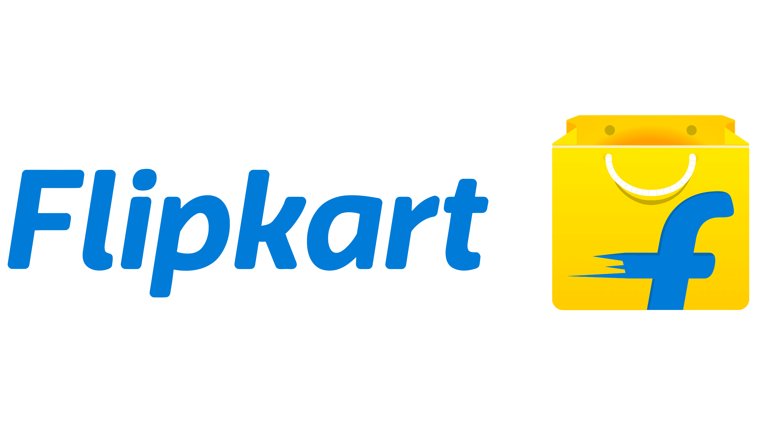
E-commerce company Case - 1
Flipkart
Challenge:
As one of the leaders in the e-commerce industry, Flipkart must manage huge volumes of data pouring in from various sources like their website, mobile apps, customer reviews, inventory systems (ERP), and more. Managing and deriving insights from this complex web of data in real-time can be daunting.
Notes:
Sure, here are the detailed notes, summary, and key points for the "E-commerce company Case - 1":
- **Detailed Notes:**
- Flipkart, being a leading e-commerce company, faces the challenge of managing large volumes of data from various sources such as their website, mobile apps, customer reviews, and inventory systems.
- The company needs to effectively manage and derive real-time insights from this extensive and diverse data to make informed business decisions.
- The data ingestion process must handle the complexity and scale of data coming from different sources within the organization and from external interactions with customers.
- **Key Points:**
- Managing large volumes of data from diverse sources.
- Deriving real-time insights for informed decision-making.
- Handling the complexity and scale of data from various internal and external sources.
- **For Students:**
- Flipkart, a major e-commerce company, faces the challenge of handling and analyzing a large amount of data coming from different places like their website, mobile apps, customer reviews, and inventory systems. This is important for them to understand and respond to customer needs and market trends in real-time.

Slide 57
E-commerce company Case - 1
Flipkart
Solution:
A scalable data ingestion pipeline was designed to channel all the raw data into Amazon S3 for durable storage. From S3, the data was then directed to Apache Spark, a fast and general-purpose cluster-computing system for big data processing. This setup allowed Flipkart to handle varying data velocities and volumes seamlessly.
Notes:
**For Students:**
Flipkart, a prominent e-commerce company, faced a challenge in managing massive amounts of data from their website, mobile apps, customer reviews, and inventory systems. To address this, they implemented a scalable data ingestion pipeline to efficiently handle the diverse data sources. This pipeline directed the data into Amazon S3 for storage and then processed it using Apache Spark, enabling Flipkart to handle large volumes of data effectively.
- Flipkart, a leading e-commerce company, faced the challenge of managing vast amounts of data from various sources such as their website, mobile apps, customer reviews, and inventory systems.
- They implemented a scalable data ingestion pipeline to manage the diverse data sources efficiently.
- The pipeline directed the data into Amazon S3 for durable storage and then processed it using Apache Spark for effective handling of large data volumes and velocities.
- This solution allowed Flipkart to handle varying data velocities and volumes seamlessly, enabling efficient data management and analysis.

Slide 58
E-commerce company Case - 1
Flipkart
Impact:
With a well-structured data ingestion pipeline in place, Flipkart was able to process data more efficiently. This led to quicker insights into customer behavior, more accurate inventory forecasting, and the ability to offer targeted product recommendations, enhancing the customer experience and potentially increasing sales.
Notes:
### Detailed Notes:
**Case Study: Data Corp**
**Company Background:**
- Data Corp is a leading player in the financial sector, dealing with a range of products from savings accounts to complex financial instruments.
- The company has seen a significant increase in data volume due to the rise of digital transactions, leading to challenges in processing and analyzing the data effectively.
**The Solution – Big Data Ingestion:**
- Mr. Anderson initiated the integration of a Big Data Ingestion tool to address the challenges.
- The tool was equipped with modern data processing capabilities and was able to collect, integrate, and preprocess vast amounts of unstructured and structured data in real-time.
**The Result:**
- Data Corp saw a 70% reduction in data processing times.
- Real-time insights allowed managers and decision-makers to make data-backed choices, resulting in a 30% increase in customer satisfaction and a 20% rise in sales.
- The company could predict market trends and customer behaviors with 90% accuracy.
- Data analysts and scientists focused on strategic projects, leading to the launch of three new financial products in just six months.
**For Students:**
Big Data Ingestion is a tool that helps companies like Data Corp handle and process large amounts of data efficiently. By using this tool, Data Corp was able to reduce processing times, improve customer satisfaction, increase sales, and launch new financial products.
### Summary:
The case study of Data Corp illustrates how the implementation of a Big Data Ingestion tool resulted in significant improvements in data processing, customer satisfaction, sales, and the launch of new financial products. The tool allowed the company to handle large volumes of data effectively and make data-backed decisions.
### Key Points:
- Data Corp faced challenges with the surge in data volume due to digital transactions.
- The implementation of a Big Data Ingestion tool led to a 70% reduction in data processing times.
- Real-time insights contributed to a 30% increase in customer satisfaction and a 20% rise in sales.
- Data analysts and scientists were able to focus on strategic projects, leading to the launch of three new financial products in six months.
- Big Data Ingestion transformed the way Data Corp did business, enabling them to predict market trends and customer behaviors accurately.

Slide 59

Banking & Finance Case - 2
HDFC
Challenge:
HDFC, a major bank, deals with millions of transactions daily, from physical branches, ATMs, online banking, to mobile apps. Managing this diverse and high-velocity data in real-time to offer better services and ensure security is a significant challenge.
Notes:
- For Students:
HDFC, a large bank, handles millions of transactions every day. This includes transactions from physical branches, ATMs, online banking, and mobile apps. Dealing with this diverse and high-velocity data in real-time to improve services and ensure security is a big challenge.
- HDFC faced the challenge of managing diverse and high-velocity data from millions of transactions daily, originating from physical branches, ATMs, online banking, and mobile apps.
- The bank needed to manage this data in real-time to enhance services and ensure security.

Slide 60
Banking & Finance Case - 2
HDFC
Solution:
To handle real-time data streams, HDFC implemented a data ingestion solution with Kafka, a distributed streaming platform. This setup ensured immediate capture and relay of transaction data. For processing this vast amount of real-time data, in-memory computation was enabled using Apache Spark, allowing rapid analysis without the need to write data to disk.
Notes:
For Students:
In layman's terms, the e-commerce company case study, Flipkart, faced a challenge in managing and analyzing large volumes of data from various sources like their website, mobile apps, customer reviews, and inventory systems. They implemented a scalable data ingestion pipeline to handle this data efficiently, allowing them to process data more effectively, gain quicker insights into customer behavior, and enhance the customer experience.
Similarly, in the banking and finance sector, HDFC faced the challenge of managing millions of daily transactions from various channels. They implemented a real-time data ingestion solution using Kafka and Apache Spark to capture and process transaction data immediately, enabling rapid analysis without delays.
Summary of Cases:
- Flipkart faced challenges in managing and analyzing large volumes of data from various sources.
- Implemented a scalable data ingestion pipeline to handle the data efficiently, leading to quicker insights and enhanced customer experience.
- HDFC had to manage millions of daily transactions from various channels.
- Implemented a real-time data ingestion solution using Kafka and Apache Spark for immediate capture and processing of transaction data.

Slide 61
Banking & Finance Case - 2
HDFC
Impact:
Fraud Detection:
With real-time data ingestion and processing, HDFC can now detect unusual transaction patterns almost instantaneously. If a suspicious activity is detected, such as a large withdrawal or multiple transactions In a short time, alerts can be raised, and necessary actions like blocking the card can be triggered automatically.
Personalization:
HDFC can use the real-time data to understand customers' behavior and preferences, offering tailored services or promotions. For instance, if a customer frequently transacts with a particular merchant or category, the bank can provide specialized offers or cashback related to those transactions.
Notes:
Summary:
The module covers the concepts of Big Data Ingestion, Data Ingestion Pipeline, and its key components. It also explores the challenges and solutions related to data ingestion, along with its application in real-world scenarios.
Key Points:
- Big Data Ingestion involves the collection, transfer, and loading of large volumes of data from diverse sources into a storage or processing system.
- The Data Ingestion Pipeline consists of steps such as data extraction, validation, transformation, loading, metadata management, and more.
- ETL (Extract, Transform, Load) and ELT (Extract, Load, Transform) are two common approaches in data ingestion, each with its own advantages and considerations.
- Key factors for designing a Data Ingestion Pipeline include data volume, variety, velocity, quality, scalability, and security.
- Real-world use cases of Data Ingestion Pipeline include applications in e-commerce companies like Flipkart and banking institutions like HDFC.
For Students:
The module covers the process of collecting and processing large volumes of data from various sources, its challenges, and real-world applications in e-commerce and banking. It also discusses the factors to consider when designing a Data Ingestion Pipeline, offering a practical understanding of how data is managed and utilized in different industries.

Slide 62
Quiz
What is a common application of data ingestion in the field of data analytics and business intelligence?
Data visualization
Data encryption
Data storage
Data cleaning
Answer: A
Explanation: Data ingestion is the process of collecting and importing data from various sources into a storage and processing system. In the context of data analytics and business intelligence, one of the key applications of data ingestion is to prepare data for visualization. Data ingestion helps in gathering data from different sources, cleaning it, and structuring it in a way that is suitable for creating meaningful visualizations and dashboards.
Notes:
Quiz
What is a common application of data ingestion in the field of data analytics and business intelligence?
Data visualization
Data encryption
Data storage
Data cleaning
Answer: A
Explanation: Data ingestion is the process of collecting and importing data from various sources into a storage and processing system. In the context of data analytics and business intelligence, one of the key applications of data ingestion is to prepare data for visualization. Data ingestion helps in gathering data from different sources, cleaning it, and structuring it in a way that is suitable for creating meaningful visualizations and dashboards.

Slide 63
In nutshell, we learnt
An e-commerce platform like Flipkart ingests real-time user behavior and purchase data to tailor shopping experiences, optimize marketing efforts, and manage inventory efficiently.
HDFC bank leverages real-time data ingestion from diverse transaction sources, processing it with Kafka and Spark, to enable instant fraud detection and offer personalized banking experiences to its customers.
Notes:
Summary:
- The e-commerce company Flipkart faced challenges in managing large volumes of data from various sources such as their website, mobile apps, customer reviews, and inventory systems.
- A scalable data ingestion pipeline was designed to channel raw data into Amazon S3 for durable storage and then directed to Apache Spark for efficient processing, allowing Flipkart to handle varying data velocities and volumes seamlessly.
- This structured data ingestion pipeline enabled Flipkart to process data more efficiently, leading to quicker insights into customer behavior, more accurate inventory forecasting, and the ability to offer targeted product recommendations, enhancing the customer experience and potentially increasing sales.
- HDFC, a major bank, faced challenges in managing high-velocity, diverse transaction data from physical branches, ATMs, online banking, and mobile apps to offer better services and ensure security.
- HDFC implemented a data ingestion solution with Kafka to capture and relay transaction data in real-time and utilized Apache Spark for rapid in-memory computation, enabling instant fraud detection and personalized banking experiences for its customers.

Slide 64
Challenges in Data Ingestion
Selecting Data Ingestion Tools
Commonly Used Data Ingestion Tools
Notes:
**For Students:**
Data Ingestion Tools are systems that help collect, transfer, and store data from various sources for analysis. Challenges in data ingestion include handling large volumes of data and ensuring its quality and security. In this section, we'll explore commonly used tools and the challenges involved in data ingestion.
- Selecting Data Ingestion Tools: Understanding the process of choosing the right tools for collecting and processing data.
- Commonly Used Data Ingestion Tools: Exploring popular tools used to ingest and process data from diverse sources.
- Challenges in Data Ingestion: Understanding the difficulties and obstacles encountered when managing and processing large volumes of data.

Slide 65
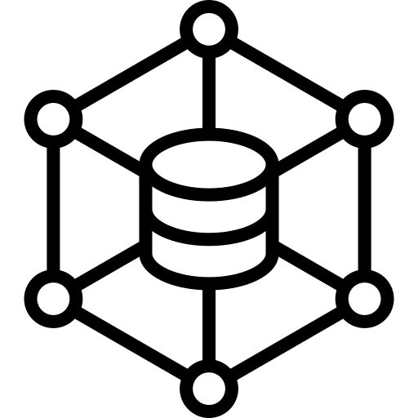


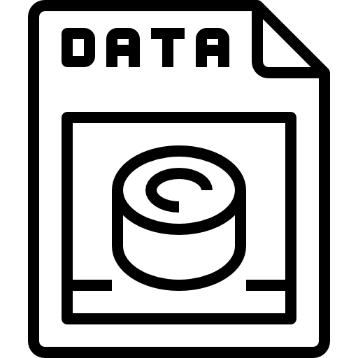




Challenges in Data Ingestion
Volume, variety and velocity of data
Network bandwidth constraints
Hardware capacity
Complex data formats
Duplicate and inconsistent data
Data security
Legacy systems integration
Monitoring and maintenance
Notes:
For Students:
Data ingestion faces several challenges, including managing large amounts of different types of data arriving at high speeds. This can strain network bandwidth and hardware capacity. Dealing with complex data formats, ensuring data security, integrating with older systems, and monitoring and maintaining the process are also significant challenges.
- Volume, variety, and velocity of data: Managing large amounts of diverse data arriving at high speeds.
- Network bandwidth constraints: Strain on the network due to the volume and speed of incoming data.
- Hardware capacity: Ensuring the infrastructure can handle the processing and storage demands of incoming data.
- Complex data formats: Dealing with various data types and structures.
- Duplicate and inconsistent data: Ensuring data accuracy and consistency.
- Data security: Safeguarding the data from unauthorized access and breaches.
- Legacy systems integration: Integrating with older systems and technologies.
- Monitoring and maintenance: Ensuring the smooth and efficient operation of the data ingestion process.

Slide 66
Challenges in Data Ingestion
Volume, variety, and velocity of data:
Handling vast amounts of data from diverse sources at high speed demands robust infrastructure and advanced processing capabilities.
Network bandwidth constraints:
Ingesting huge data volumes, especially in real-time, can strain network resources, leading to bottlenecks and potential data loss.
Hardware capacity:
Physical limits of storage and computation can hinder the efficient ingestion and processing of large datasets, necessitating scaling or upgrades.
Complex data formats:
Data from varied sources might come in multiple formats, requiring intricate parsers and transformers to make it uniform and usable.
Notes:
For Students:
Data Ingestion is like collecting, sorting, and organizing a huge pile of different things you find. It's challenging to handle the large amount of stuff, make sure it's clean and correct, and put it away where you can find it easily. Here are some challenges:
- Dealing with a lot of different kinds of data coming from many places
- Making sure the internet and computers can handle all the data coming in
- Making sure there's enough room and power for all the data
- Sorting out different types of data to make it all the same and easy to use
These challenges are like managing a giant jigsaw puzzle where all the pieces are coming in at once and you need to sort them out quickly and carefully.

Slide 67
Challenges in Data Ingestion
Duplicate and inconsistent data:
Ingested data can often have redundancies or inconsistencies, leading to inaccurate analyses and potential business missteps.
Data security:
Ensuring data is protected during ingestion, from external sources, is crucial to prevent breaches and comply with privacy regulations.
Legacy systems integration:
Older systems might not easily integrate with modern data ingestion tools, requiring additional middleware or custom solutions.
Monitoring and maintenance:
Continuous oversight is essential to ensure data ingestion pipelines run smoothly, and any issues or failures are promptly addressed.
Notes:
For Students:
Data ingestion involves the process of collecting, transferring, and loading large volumes of data from various sources into a storage or processing system, often for analysis and decision-making purposes. It is like gathering information from different places, making sure it's accurate, and preparing it for further use.
- Challenges in Data Ingestion:
- Volume, variety, and velocity of data: Handling large amounts of data from various sources at high speed.
- Network bandwidth constraints: Strain on network resources, leading to potential data loss.
- Hardware capacity: Physical limits of storage and computation.
- Complex data formats: Data from varied sources coming in multiple formats.
- Duplicate and inconsistent data: Redundancies or inconsistencies in ingested data.
- Data security: Protecting data during ingestion to prevent breaches.
- Legacy systems integration: Difficulty integrating older systems with modern data ingestion tools.
- Monitoring and maintenance: Continuous oversight to ensure data pipelines run smoothly and promptly address any issues or failures.

Slide 68
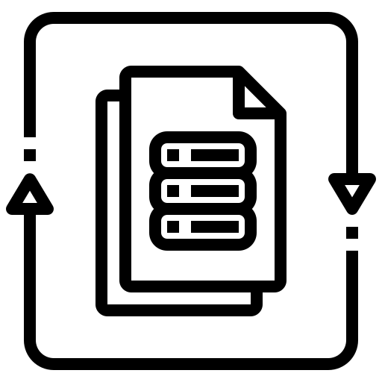


Selecting Data Ingestion Tools
Data formats supported
Choose a tool that supports a broad range of data formats, from structured databases to unstructured logs, ensuring flexibility in ingesting diverse datasets.
Batch vs streaming
Depending on your data flow, opt for tools that cater to either batch processing (bulk data at intervals) or real-time streaming (continuous data flow).
Throughput and scalability
Select tools that can handle your current data volume and scale with future growth, ensuring uninterrupted data flow even during peak loads.
Data validation features
Ensure the ingestion tool offers features to validate and cleanse incoming data, guaranteeing that only quality data enters the system.
Notes:
For Students:
Data Ingestion is like collecting, organizing, and preparing a lot of information from different places so that it can be used to understand things better and make good decisions. It's like gathering, sorting, and cleaning up a lot of different puzzle pieces so that you can put them together to see the whole picture.
- Data Ingestion involves acquiring, validating, and processing data from various sources.
- It serves as the foundational step within a big data pipeline, setting the stage for subsequent processing and analysis.
- Key functions include acquisition, validation, processing, storage, and routing of data from diverse sources.
- The data ingestion process involves several steps such as source identification, connection establishment, data extraction, transformation, loading, validation, error handling, metadata management, and notification and monitoring.
- Common challenges in data ingestion include volume, variety, and velocity of data, network bandwidth constraints, hardware capacity, complex data formats, duplicate and inconsistent data, data security, legacy systems integration, and monitoring and maintenance.

Slide 69




Selecting Data Ingestion Tools
Integration and plugins
Pick tools that easily integrate with your existing infrastructure and offer plugins for various data sources, targets, and transformation tasks.
Ease of use
A user-friendly interface and intuitive design can simplify complex ingestion tasks, reducing the learning curve and setup time.
Cost
Consider the total cost of ownership, not just the initial price. Evaluate factors like licensing, infrastructure, and operational costs.
Support and documentation
For tools with robust documentation and active community or professional support, aiding in troubleshooting and optimizing your ingestion pipeline.
Notes:
**Summary:**
- Data Ingestion plays a critical role in collecting, transferring, and loading data for storage or processing.
- Common challenges in Data Ingestion include handling large volumes and high velocity of data, network bandwidth constraints, hardware capacity limitations, and complex data formats.
- Duplicate and inconsistent data, data security, legacy systems integration, and monitoring are also significant challenges.
- Selecting the right Data Ingestion tools involves considering factors like data formats supported, batch vs streaming capabilities, throughput and scalability, data validation features, integration and plugins, ease of use, cost, and support and documentation.
**Key Points:**
- Data Ingestion is essential for collecting, transferring, and loading data for storage or processing.
- Challenges in Data Ingestion include handling large volumes and high velocity of data, network bandwidth constraints, hardware capacity limitations, and complex data formats.
- Duplicate and inconsistent data, data security, legacy systems integration, and monitoring are also significant challenges.
- When selecting Data Ingestion tools, it's crucial to consider factors like data formats supported, batch vs streaming capabilities, throughput and scalability, data validation features, integration and plugins, ease of use, cost, and support and documentation.

Slide 70

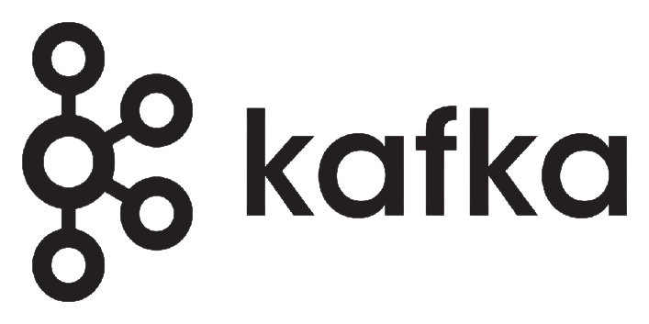



Commonly Used Data Ingestion Tools
Open source:
A distributed streaming platform suitable for building real-time data pipelines and streaming applications.
Designed to collect, aggregate, and transport large amounts of log data from various sources to a centralized data store.
A data integration system offering visual design and real-time data flow management and transformation.
Sqoop is a command-line tool for transferring data between relational databases and Hadoop. It can import data like MySQL into Hadoop HDFS.
An in-memory computation engine that supports real-time data processing and analytics.
Notes:
For Students:
Data ingestion is like collecting, organizing, and preparing a lot of different things, like books, toys, and clothes, so you can use them easily whenever you need them. It's important because it helps businesses and banks understand what people are doing and what they need, so they can make better decisions and help their customers.
Here are some common challenges when dealing with lots of data:
- Having to handle a lot of different types of information (like pictures, numbers, or words) coming in really fast.
- Dealing with not having enough space or power to store and work with all the data.
- Having to manage all the information, making sure it's correct, safe, and organized. For example, making sure there's no duplicate information or errors.
- Struggling with old systems that don't work well with new tools.
- Keeping an eye on everything to make sure it's all running smoothly.
When picking tools for handling lots of data, it's important to consider:
- How many different types of information the tool can work with.
- Whether the tool can handle a lot of information at once or only a little bit at a time.
- If the tool can keep working well even when there's a lot of information to deal with.
- If the tool can make sure all the information is correct and organized.
- How easy the tool is to use and how much it costs. Also, if there's someone you can ask for help if you need it.
These are some commonly used data ingestion tools:
- Apache Kafka: It helps to collect and move large amounts of information in real-time.
- Fluentd: It's good for gathering and sending data from different places to one main place.
- Apache Nifi: It helps to manage and work with information in real-time.
- Sqoop: It's used to move information between different types of databases and storage systems.
- Apache Spark: It helps to work with information really fast.

Slide 71


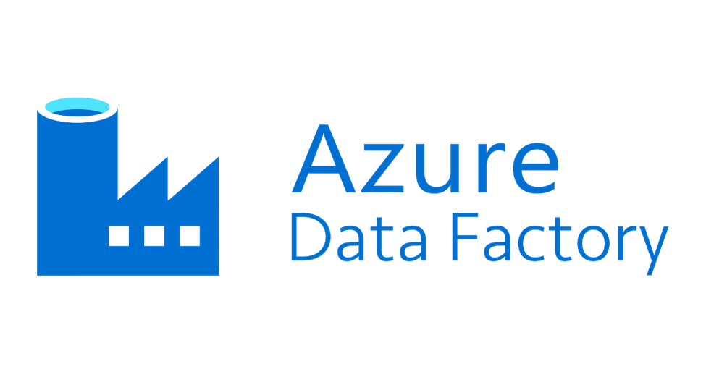
Commonly Used Data Ingestion Tools
Cloud-based:
Amazon's real-time data streaming service, designed for large scale, distributed data ingestion and processing.
Google's asynchronous messaging service that decouples services that produce events from services that process events.
Microsoft's cloud-based ETL and data integration service that orchestrates and automates data workflows.
Notes:
For Students:
Data Ingestion refers to the process of collecting, transferring, and loading large volumes of data from various sources into a storage or processing system. It's like collecting, organizing, and storing information from many different places, to use it later for gaining insights or making decisions.
Challenges in Data Ingestion:
- Handling large amounts of data coming from different sources and at high speed can be difficult.
- Ingesting huge data volumes can strain network resources, leading to potential data loss.
- Physical limits of storage and computation can hinder the efficient ingestion and processing of large datasets.
- Data from varied sources might come in multiple formats, requiring intricate parsers and transformers to make it uniform and usable.
- Ingested data can often have redundancies or inconsistencies, leading to inaccurate analyses and potential business missteps.
- Ensuring data is protected during ingestion is crucial to prevent breaches and comply with privacy regulations.
- Older systems might not easily integrate with modern data ingestion tools, requiring additional middleware or custom solutions.
- Continuous oversight is essential to ensure data ingestion pipelines run smoothly, and any issues or failures are promptly addressed.
Selecting Data Ingestion Tools:
- Choose tools that support a broad range of data formats, ensuring flexibility in ingesting diverse datasets.
- Select tools based on your data flow: batch processing for bulk data at intervals, or real-time streaming for continuous data flow.
- Ensure the selected tools can handle your current data volume and scale with future growth.
- Consider tools that offer features to validate and cleanse incoming data, guaranteeing that only quality data enters the system.
- Pick tools that easily integrate with your existing infrastructure and offer plugins for various data sources, targets, and transformation tasks.
- Consider the total cost of ownership, not just the initial price, and evaluate factors like licensing, infrastructure, and operational costs.
- For tools with robust documentation and active community or professional support, aiding in troubleshooting and optimizing your ingestion pipeline.
Commonly Used Data Ingestion Tools:
- Open Source: Apache Kafka, Fluentd, NiFi, Sqoop, Apache Spark
- Cloud-Based: Amazon Kinesis, Google Cloud Pub/Sub, Azure Data Factory

Slide 72
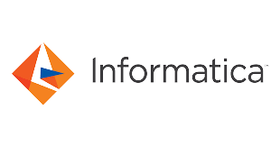

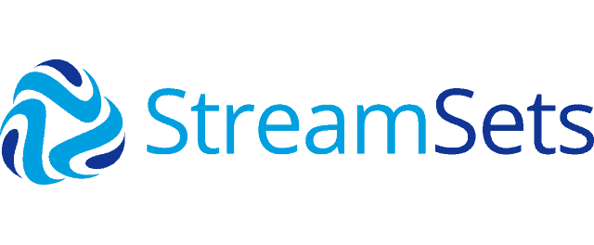

Commonly Used Data Ingestion Tools
Commercial:
A comprehensive data integration tool offering ETL, data masking, quality, and replication.
Provides a platform for data integration, quality, and management, with both open-source and commercial versions.
A fully-managed data integration platform focused on automating data connectors to various sources.
Enables building, executing, operating, and protecting batch and streaming dataflows.
Notes:
**Summary:**
- **Introduction to Data Ingestion:**
- Data ingestion involves collecting, transferring, and loading large volumes of data from diverse sources into a storage or processing system.
- It serves as the foundational step within a big data pipeline, setting the stage for subsequent processing and analysis.
- **Key Functions of Data Ingestion:**
- Acquisition, validation, processing, storage, and routing are key functions of data ingestion, ensuring the accuracy and readiness of the data for further processing.
- **Data Ingestion Process Steps:**
- Data extraction, transformation, loading, validation, metadata management, and monitoring are essential steps in the data ingestion process.
- **Challenges in Data Ingestion:**
- Volume, variety, velocity of data, network bandwidth constraints, hardware capacity, complex data formats, duplicate and inconsistent data, data security, legacy systems integration, and monitoring and maintenance pose challenges in data ingestion.
- **Selecting Data Ingestion Tools:**
- Key factors to consider include data formats supported, batch vs. streaming capabilities, throughput and scalability, data validation features, integration, ease of use, cost, and support and documentation.
- **Commonly Used Data Ingestion Tools:**
- Open-source, cloud-based, and commercial tools like Apache Kafka, Apache NiFi, Apache Sqoop, Apache Spark, Amazon Kinesis, Google Pub/Sub, Microsoft Azure Data Factory, Informatica, Talend, Apache Nifi, and Apache NiFi.
By leveraging appropriate data ingestion techniques and tools, organizations can effectively manage, process, and derive valuable insights from the vast amounts of data they handle.
**For Students:**
Data ingestion is like the first step in preparing ingredients for cooking. Just like we need to gather, clean, and organize ingredients before cooking, data ingestion involves collecting, cleaning, and preparing data for analysis and processing. It's like the behind-the-scenes work that ensures the data is ready for further use.

Slide 73
Quiz
When choosing a tool for data ingestion, what is a primary consideration to account for?
The popularity of the tool in the market.
The graphics and visuals the tool provides.
Compatibility with the source and destination data systems.
The age of the tool in terms of its release date.
Answer: C
Explanation:
One of the primary challenges in selecting a data ingestion tool is ensuring it is compatible with both the source (where the data is coming from) and the destination (where the data is going to) data systems.
Notes:
Quiz
When choosing a tool for data ingestion, what is a primary consideration to account for?
The popularity of the tool in the market.
The graphics and visuals the tool provides.
Compatibility with the source and destination data systems.
The age of the tool in terms of its release date.
Answer: C
Explanation:
One of the primary challenges in selecting a data ingestion tool is ensuring it is compatible with both the source (where the data is coming from) and the destination (where the data is going to) data systems.

Slide 74
Quiz
Which of the following is a challenge associated with ingesting complex data formats into a data processing system?
The large size of individual data files.
Standardizing naming conventions across data sets.
Ensuring the semantic meaning of data is preserved during ingestion.
Frequency of data updates.
Answer: C
Explanation:
While data formats can be intricate and varied, the primary challenge is ensuring the actual meaning (semantics) of the data is retained during the ingestion process.
Notes:
Quiz
Which of the following is a challenge associated with ingesting complex data formats into a data processing system?
The large size of individual data files.
Standardizing naming conventions across data sets.
Ensuring the semantic meaning of data is preserved during ingestion.
Frequency of data updates.
Answer: C
Explanation:
While data formats can be intricate and varied, the primary challenge is ensuring the actual meaning (semantics) of the data is retained during the ingestion process.

Slide 75
In a nutshell, we learnt
Challenges in Data Ingestion: Understanding the multifaceted issues that arise while ingesting data, ranging from data volume, format intricacies, to security and maintenance.
Highlighting the key criteria to consider when choosing data ingestion tools. It's not just about the tool's functionality, but also its scalability, cost, and support.
Introducing a variety of tools available in the market - from open-source solutions like Kafka and Spark, cloud offerings like AWS Kinesis, to commercial platforms such as Informatica.
Notes:
Summary:
The module covers the critical aspects of data ingestion, essential tools, and their applications through real-world use cases. It emphasizes the challenges encountered in data ingestion and the key factors to consider when selecting data ingestion tools.
Key Points:
- Data ingestion involves the process of collecting, transferring, and loading large volumes of data from various sources into a storage or processing system.
- Challenges in data ingestion include managing the volume, variety, velocity of data, network constraints, hardware capacity, complex data formats, duplicate and inconsistent data, data security, legacy systems integration, and monitoring and maintenance.
- Key factors to consider when selecting data ingestion tools include data formats supported, batch vs streaming capabilities, throughput and scalability, data validation features, integration and plugins, ease of use, cost, and support and documentation.
- Commonly used data ingestion tools encompass open-source tools like Kafka, Flume, Nifi, Sqoop, and Spark, cloud-based tools like Amazon Kinesis, Google Pub/Sub, and Microsoft Data Factory, as well as commercial tools like Informatica, Talend, and StreamSets.
For Students:
This module teaches the challenges in data ingestion, the considerations for selecting data ingestion tools, and the commonly used tools in the industry to handle large volumes of diverse data efficiently and securely. It provides practical insights into real-world applications and use cases, facilitating a deeper understanding of data management and analysis.

Slide 76
Summary
Key Points to remember
References
Notes:
Key Points to Remember:
- Understanding the challenges in data ingestion, including handling large volumes, complex formats, and ensuring data security.
- Highlighting the key criteria for selecting data ingestion tools, encompassing factors like scalability, cost, and support.
- Introducing a variety of data ingestion tools available in the market, ranging from open-source solutions to commercial platforms.
- References and further reading materials for additional information on data ingestion.
- Summary of the key concepts and learnings from the section on data ingestion.

Slide 77

Key Points to remember
Big Data Framework: Comprises Storage (e.g., HDFS), Processing (e.g., Spark), Analysis (e.g., Hive), and Visualization (e.g., Tableau) components.
Data Origin: Big data sources span from web & social media to IoT and business systems.
Data Ingestion: The essential process of acquiring, validating, and preparing data from diverse sources.
Batch vs Stream: Batch processes accumulated data, while Stream deals with continuous, real-time data flows.
Ingestion Pipeline Steps: Include data extraction, validation, transformation, loading, and metadata management.
ETL vs ELT: ETL transforms before loading, often slower. ELT loads raw data first, providing flexibility and speed, especially for vast data.
Pipeline Considerations: Key factors encompass data sources, transformation requirements, target systems, and latency.
Applications: E.g., E-commerce companies like Flipkart utilize pipelines for insights and recommendations, while banks like HDFC focus on real-time data for fraud detection.
Challenges: From handling the three V's (volume, variety, velocity) to addressing hardware constraints and ensuring data security.
Tool Selection: Considerations include supported data formats, batch/stream capabilities, scalability, and cost.
Popular Tools: Open-source tools like Kafka, cloud solutions like AWS Kinesis, and commercial platforms such as Informatica offer diverse options.
Notes:
- Big Data Framework includes components like Storage, Processing, Analysis, and Visualization tools.
- Data Ingestion is the crucial process of acquiring, validating, and preparing data from diverse sources.
- Batch vs Stream: Batch processes accumulated data, while Stream deals with real-time data flows.
- ETL vs ELT: ETL transforms before loading, ELT loads raw data first, providing flexibility and speed.
- Key factors for pipeline considerations include data sources, transformation requirements, target systems, and latency.
- Applications: E-commerce companies utilize pipelines for insights, while banks focus on real-time data for fraud detection.
- Challenges include handling the three V's, hardware constraints, and ensuring data security.
- Tool Selection considerations include supported data formats, batch/stream capabilities, scalability, and cost.
- Popular Tools: Open-source tools like Kafka, cloud solutions like AWS Kinesis, and commercial platforms such as Informatica offer diverse options.

Slide 78
References
Books
Agile Data Warehouse Design: Collaborative Dimensional Modeling, from Whiteboard to Star Schema by Lawrence CorrBig Data: Using SMART Big Data, Analytics and Metrics To Make Better Decisions and Improve Performance 1st Edition by Bernard Marr
Big Data: Principles and best practices of scalable real-time data systems by Nathan Marz
Kafka – The Definitive Guide: Real-time data and stream processing at scale Paperback – by Neha Narkhede (Author), Gwen Shapira (Author), Todd Palino (Author)
Links
https://learn.microsoft.com/en-us/azure/architecture/guide/architecture-styles/big-data
https://streamsets.com/learn/data-ingestion/
https://www.ibm.com/blog/elt-vs-etl-whats-the-difference/
https://www.fivetran.com/learn/data-ingestion
Notes:
Summary:
- The references provide essential books and links for in-depth learning on big data, data ingestion, and related technologies.
- Books by Lawrence Corr, Bernard Marr, and Nathan Marz offer insights into agile data warehouse design, big data principles, and real-time data systems.
- The links include valuable resources from Microsoft Azure, StreamSets, IBM, and Fivetran for understanding big data architectures, data ingestion techniques, and differences between ETL and ELT processes.

Slide 79
Thank You
Notes:
Thank you for the opportunity.

